Slide 1
Research Topic:
A Millimeter-Wave RFID Passive Tag IC Using In-Phase Gate-Boosting Rectifier
Speaker：I-No Liao
Advisor：Dr. Yu-Jiu Wang

Slide 2
Outline
Introduction
A Millimeter-Wave RFID Tag IC
A Millimeter-Wave In-Phase Gate-Boosting Rectifier
Conclusion and Future Works

Slide 3
Introduction

Slide 4
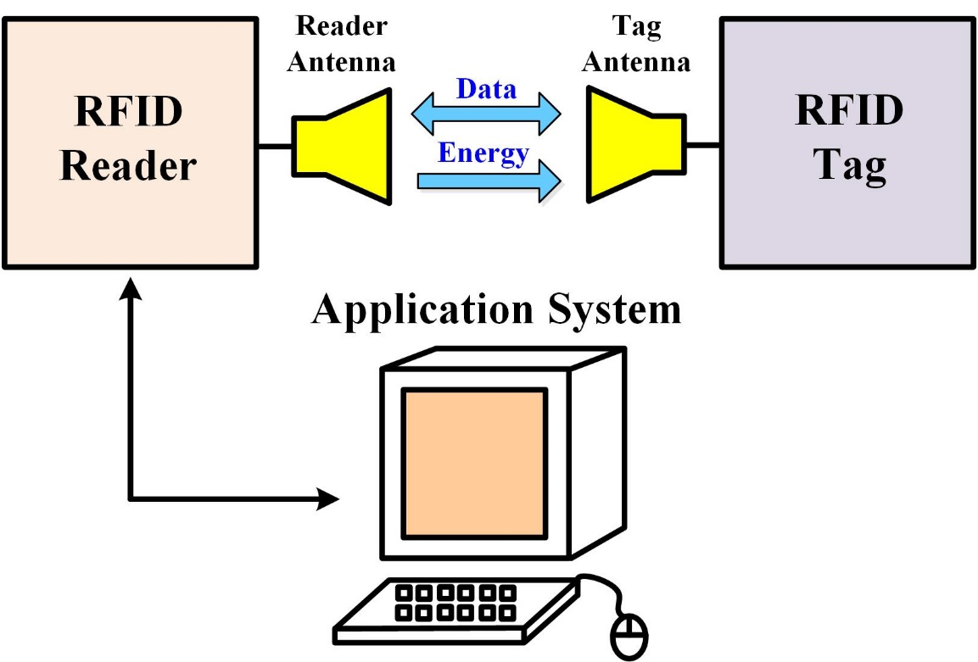
Introduction
RFID system includes
Tag, reader, and the application system
Application variety is limited mainly by the size of a tag
This research focuses on designing a small tag
Notes:
Introduce RFID system
Application limitation
Operation of the tag (data and energy)

Slide 5
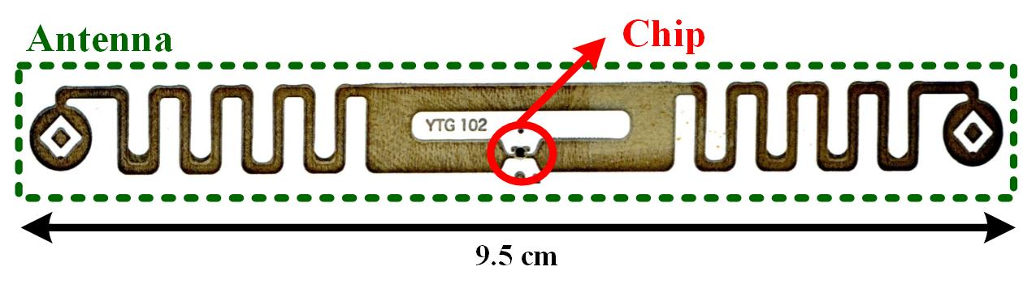
Introduction
RFID tag size is determined by the antenna
How to reduce the size?
Use higher operating frequency to shrink the antenna dimensions
1 mm² is the target
Why should the size be minimized?
Increase the variety of RFID applications

Slide 6
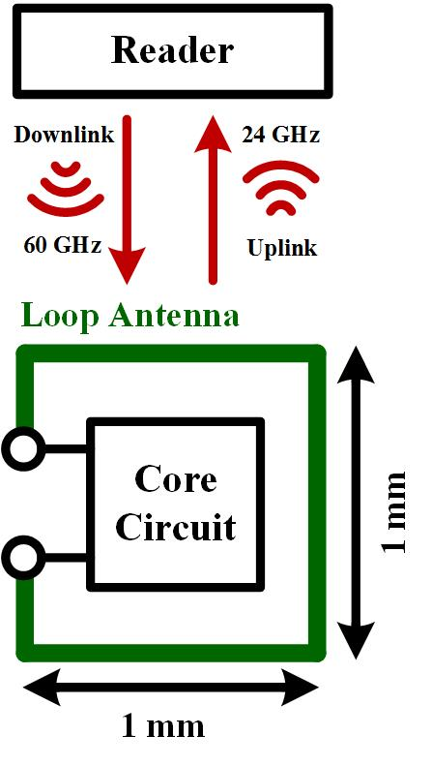
Introduction
Specification of the proposed RFID
Antenna is shrunk by using 60 GHz downlink and 24 GHz uplink frequencies with one on-chip loop antenna
1 mm² tag size is achieved
Item | Specification
Downlink | 60 GHz
Downlink Mode | PWM Modulation
Uplink | 24 GHz
Uplink Mode | FSK Modulation
Data Rate | 200 Mbps
Supply Voltage | 0.6 – 1.2V
Tag Size | 1 mm by 1 mm

Slide 7
A Millimeter-Wave RFID Tag IC

Slide 8
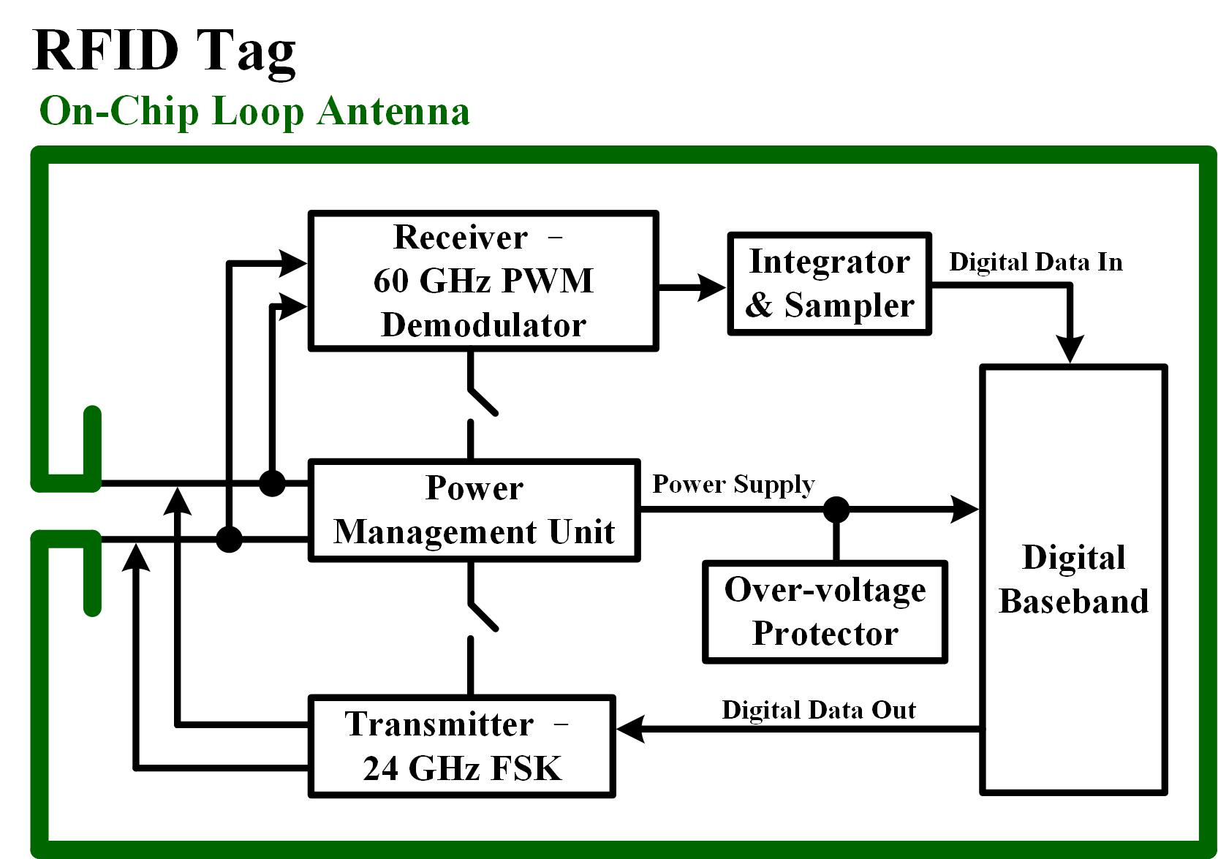
A Millimeter-Wave RFID Tag IC
System block diagram
Notes:
Introduce all circuit blocks and their functions
Do not emphasize rectifier by now

Slide 9
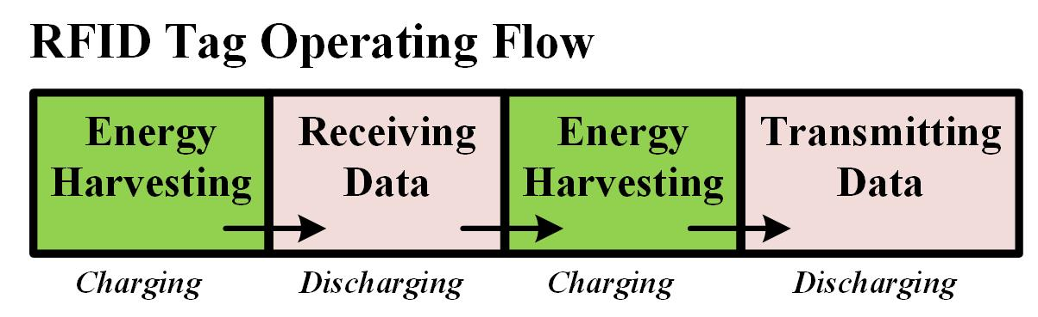
A Millimeter-Wave RFID Tag IC
Tag operating flow
1st working phase: Scavenge energy from surroundings
2nd working phase: Receive PWM signal – Downlink mode
3rd working phase: Scavenge energy from surroundings
4th working Phase: Transmit FSK signal – Uplink mode
The most critical design is the rectifier in this tag
Increase the tag sensitivity to RF energy in the environment is the design target
Notes:
Emphasize the critical block: Rectifier

Slide 10
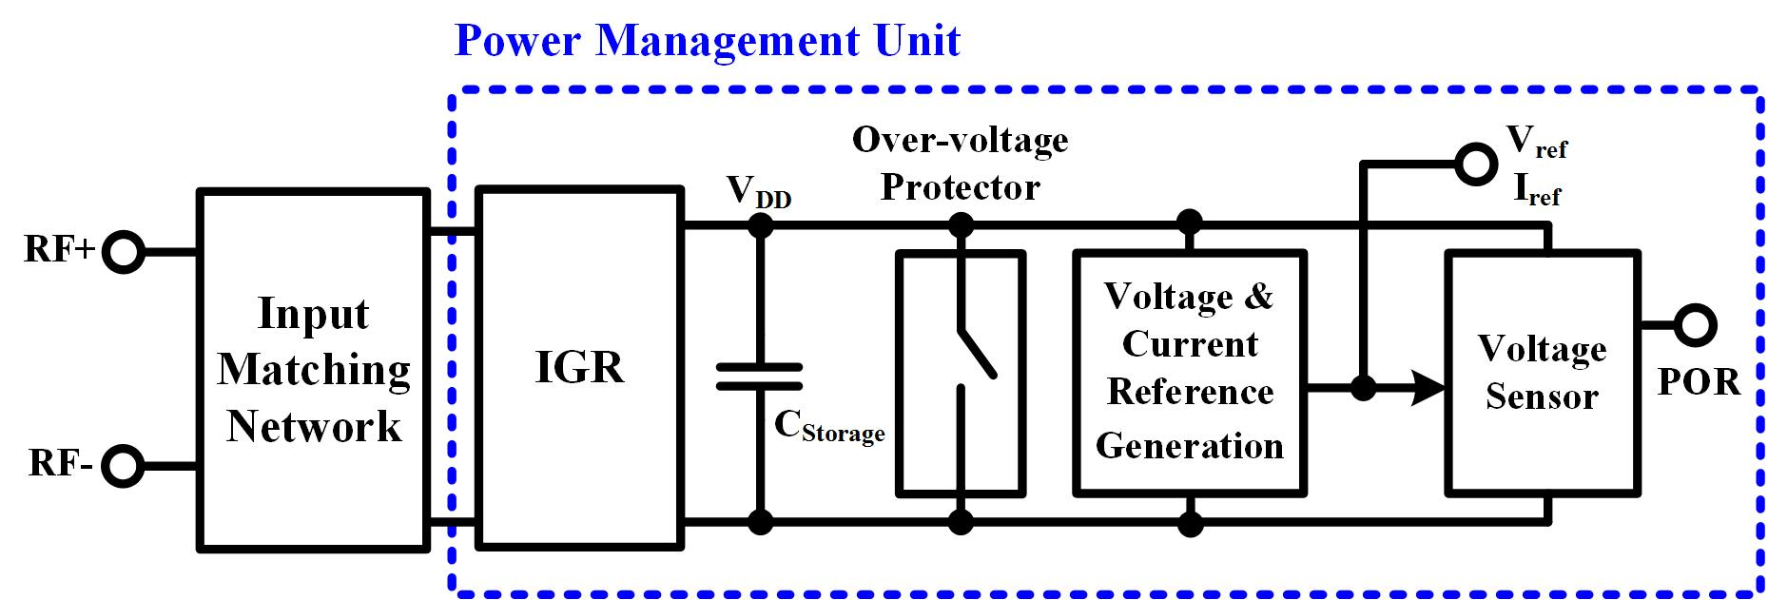
A Millimeter-Wave RFID Tag IC
Power Management Unit
Manage the power supply of other working units by generating Power-On-Reset (POR) signal
PMU works through all four working phases
PMU must consume little power
Rectifier must have high RF-to-dc sensitivity
PMU block diagram
Notes:
Introduce the operating principle of PMU
Introduce Power-On-Reset (POR) signal
Design concern: Low power consumption and high RF-to-dc sensitivity

Slide 11
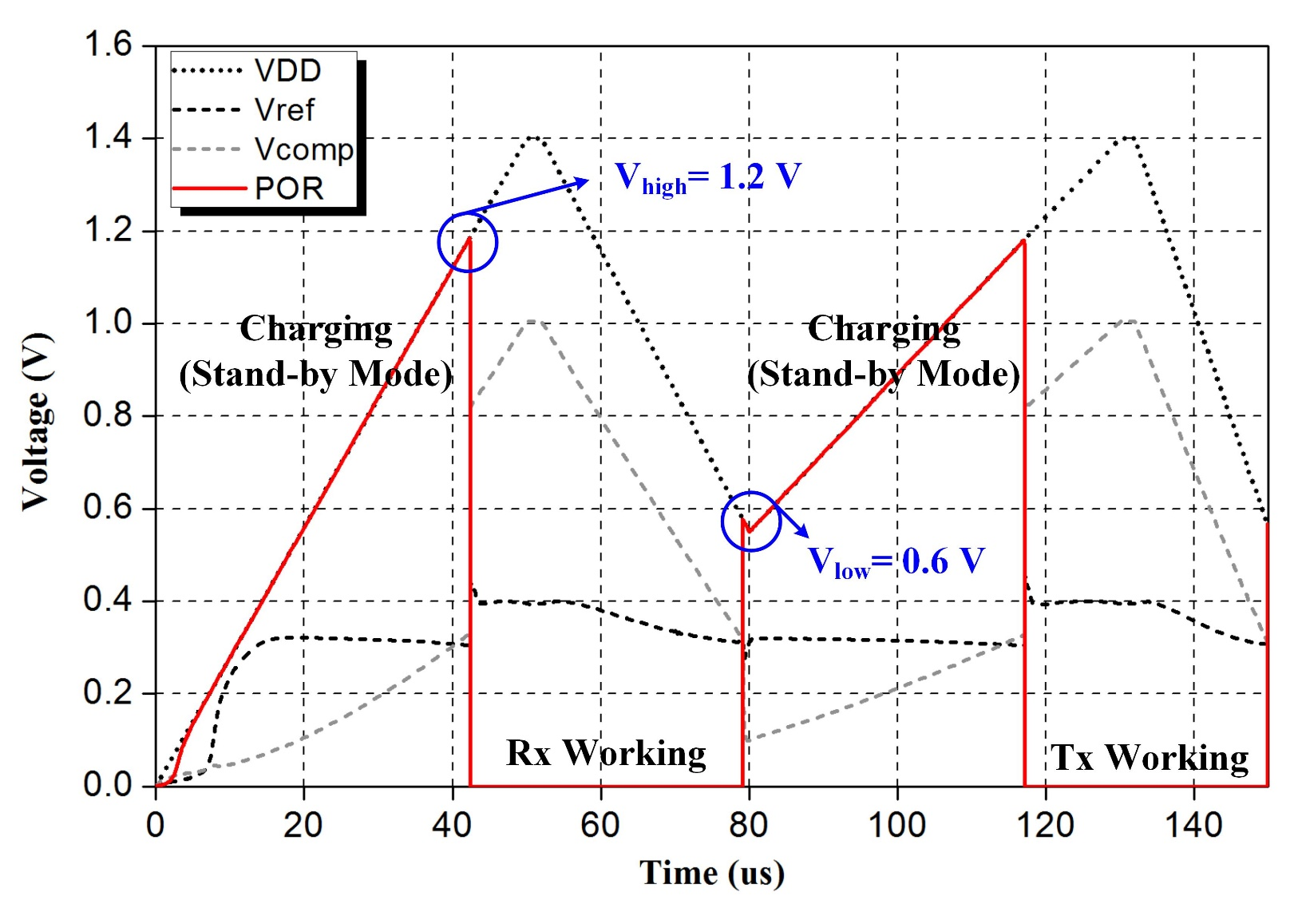
A Millimeter-Wave RFID Tag IC
POR signal simulation
Notes:
Explain POR
Voltage sensor monitors VDD by creating Vref and Vcomp

Slide 12
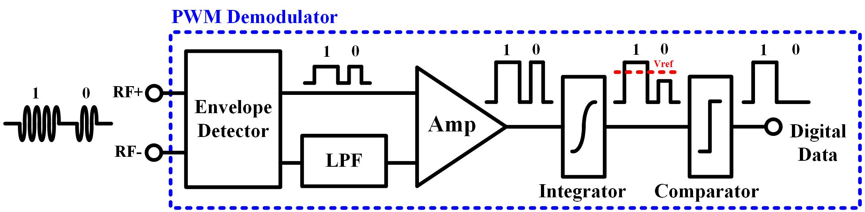
A Millimeter-Wave RFID Tag IC
60 GHz receiver using PWM demodulator
Demodulate PWM signal into digital data
Work in the 2nd working phase – Downlink mode
Receiver block diagram
Detect 200 MHz envelope of the 60 GHz PWM signal
Amplified the demodulated signal
After integration, the digital data are received
Notes:
Introduce the operating principle of the receiver

Slide 13
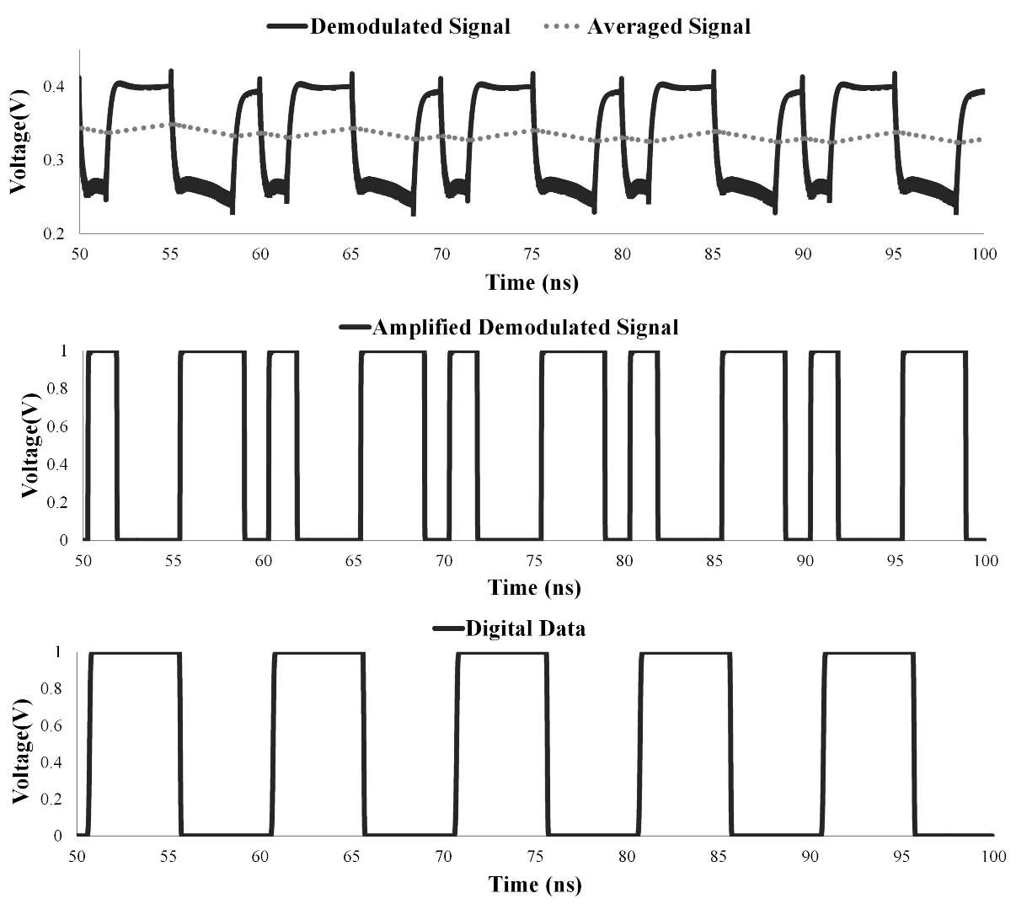
A Millimeter-Wave RFID Tag IC
PWM demodulator simulation

Slide 14
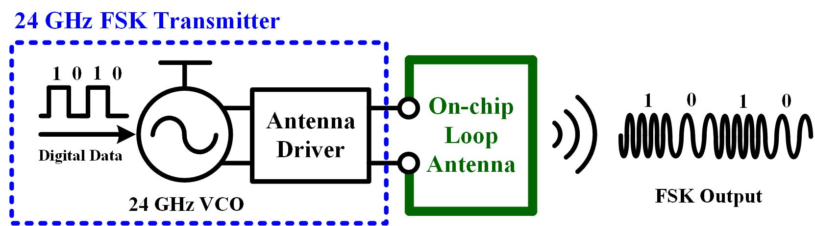
A Millimeter-Wave RFID Tag IC
24 GHz FSK transmitter
Modulate digital data using Frequency Shift Keying
Work in the 4th working phase – Uplink mode
Transmitter block diagram
Frequency of VCO is controlled by digital data
Antenna driver amplifies the signal power
FSK signal is radiated by the antenna
Notes:
Introduce the operating principle of the transmitter

Slide 15
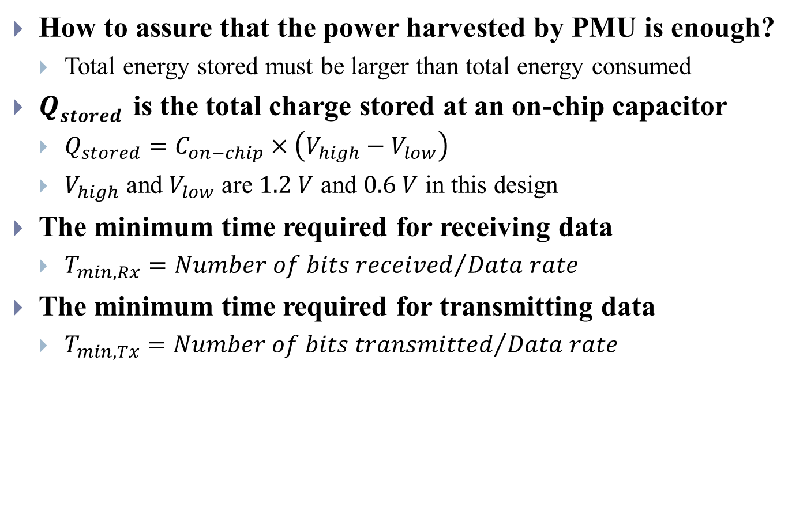
A Millimeter-Wave RFID Tag IC
How to assure that the power harvested by PMU is enough?
Total energy stored must be larger than total energy consumed
$Qstored$ is the total charge stored at an on-chip capacitor
$Q_{stored}=C_{on−chip}×\left(V_{high}−V_{low}\right)$
$V_{high}$ and $V_{low}$ are $1.2 V$ and $0.6 V$ in this design
The minimum time required for receiving data
$T_{min,Rx}={Number of bits received}/{Data rate}$
The minimum time required for transmitting data
$T_{min,Tx}={Number of bits transmitted}/{Data rate}$

Slide 16
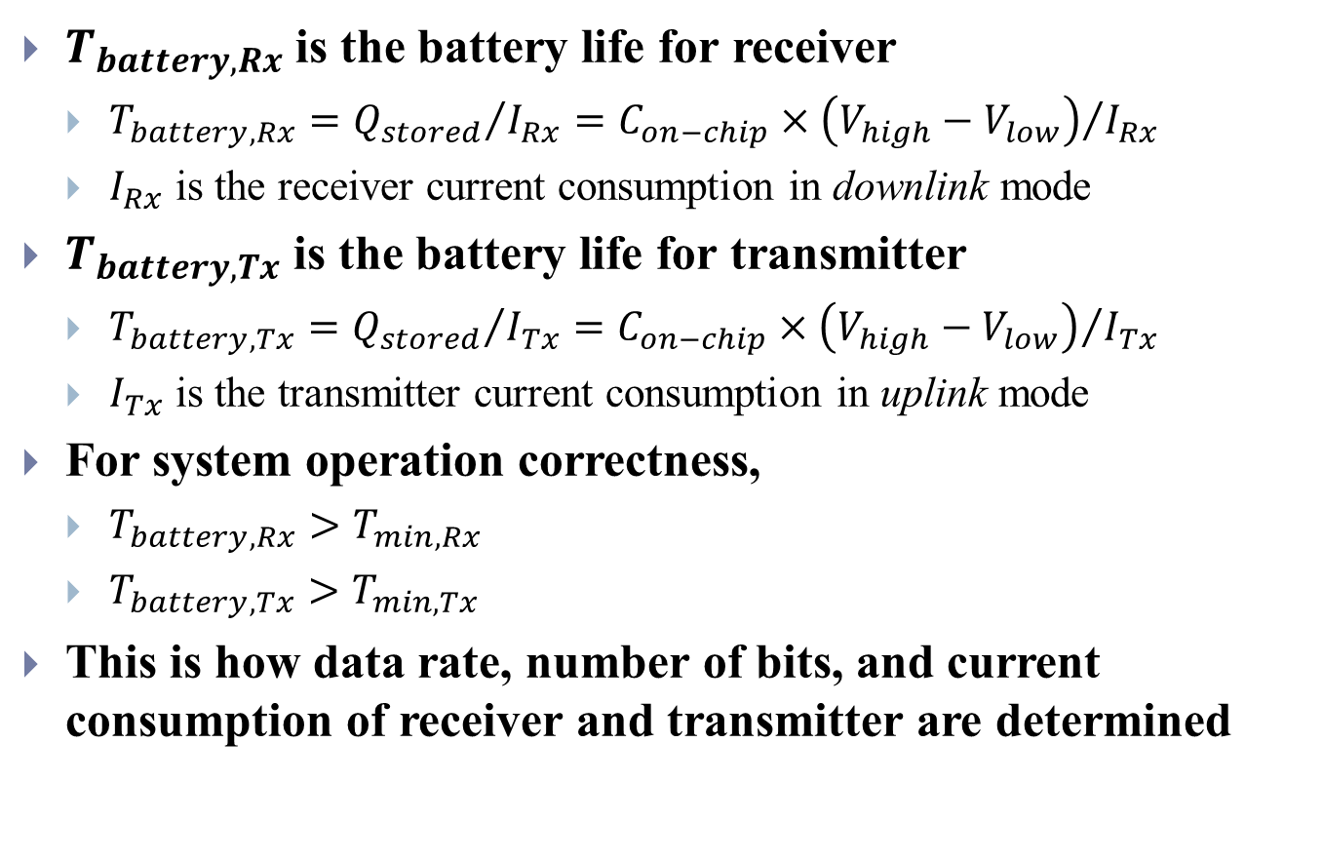
A Millimeter-Wave RFID Tag IC
$T_{battery,Rx}$ is the battery life for receiver
$T_{battery,Rx}={Q_{stored}}/{I_{Rx}}={C_{on−chip}×\left(V_{high}−V_{low}\right)}/{I_{Rx}}$
$I_{Rx}$ is the receiver current consumption in downlink mode
$T_{battery,Tx}$ is the battery life for transmitter
$T_{battery,Tx}={Q_{stored}}/{I_{Tx}}={C_{on−chip}×\left(V_{high}−V_{low}\right)}/{I_{Tx}}$
$I_{Tx}$ is the transmitter current consumption in uplink mode
For system operation correctness,
$T_{battery,Rx}>T_{min,Rx}$
$T_{battery,Tx}>T_{min,Tx}$
This is how data rate, number of bits, and current consumption of receiver and transmitter are determined

Slide 17
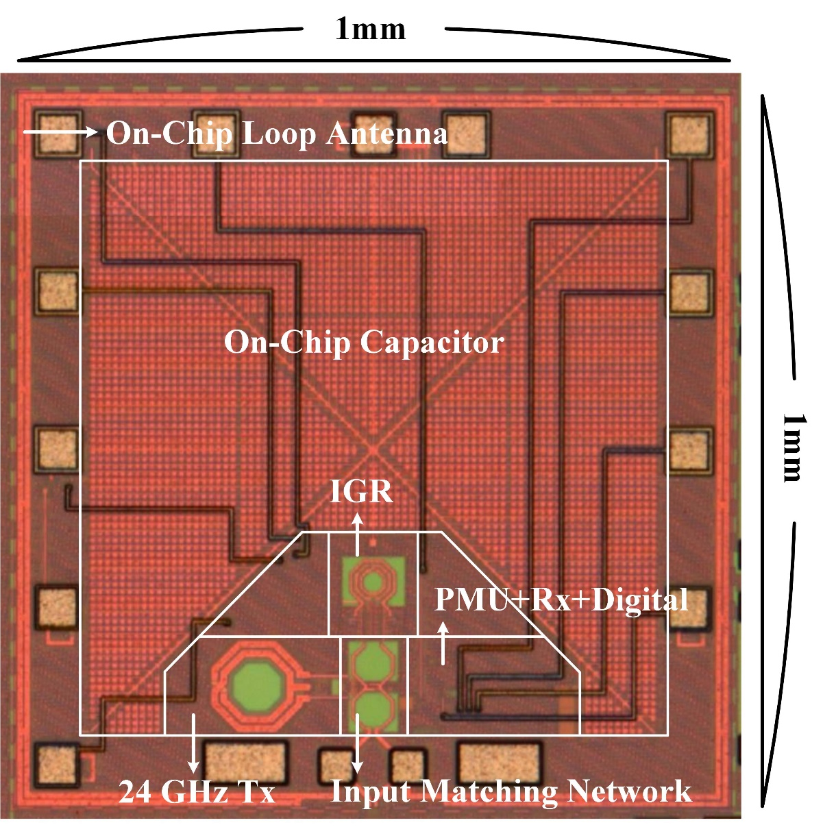
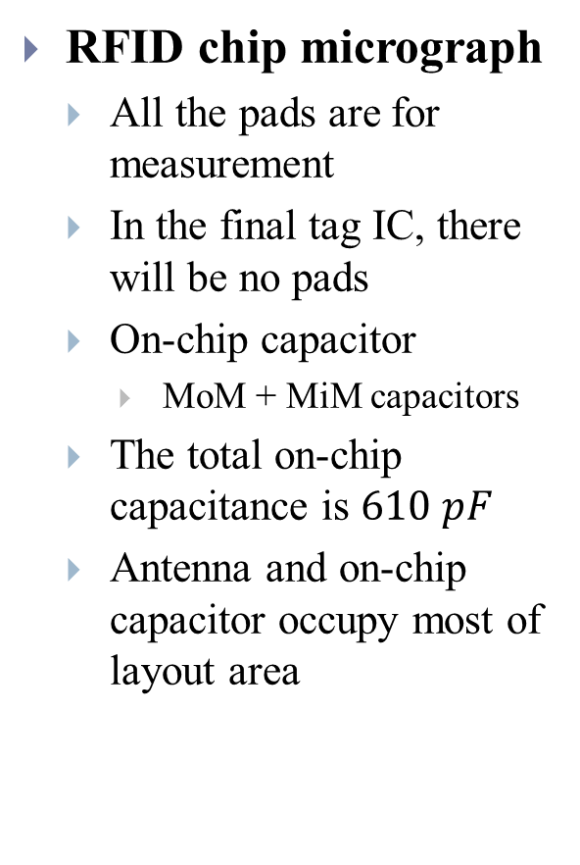
A Millimeter-Wave RFID Tag IC
RFID chip micrograph
All the pads are for measurement
In the final tag IC, there will be no pads
On-chip capacitor
MoM + MiM capacitors
The total on-chip capacitance is $610 pF$
Antenna and on-chip capacitor occupy most of layout area

Slide 18
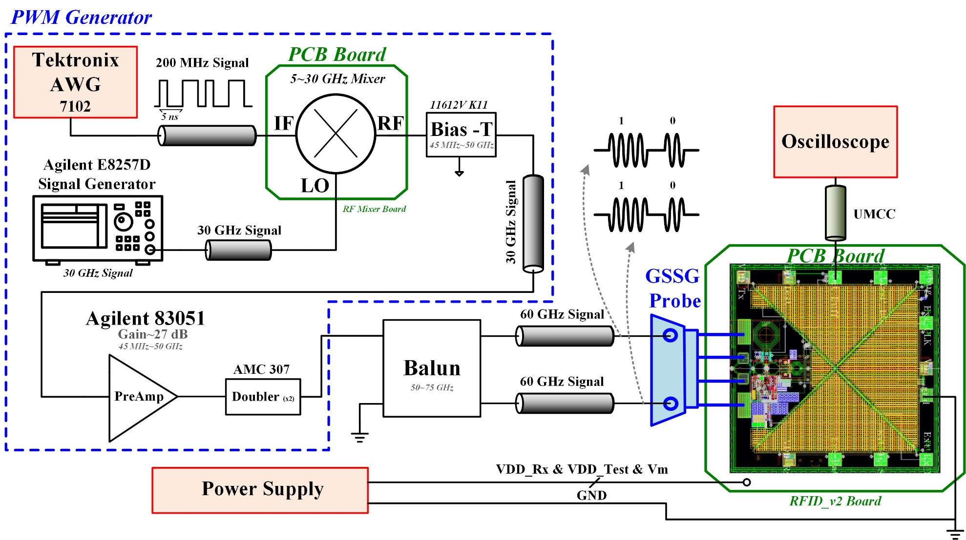
A Millimeter-Wave RFID Tag IC
Receiver measurement setup

Slide 19
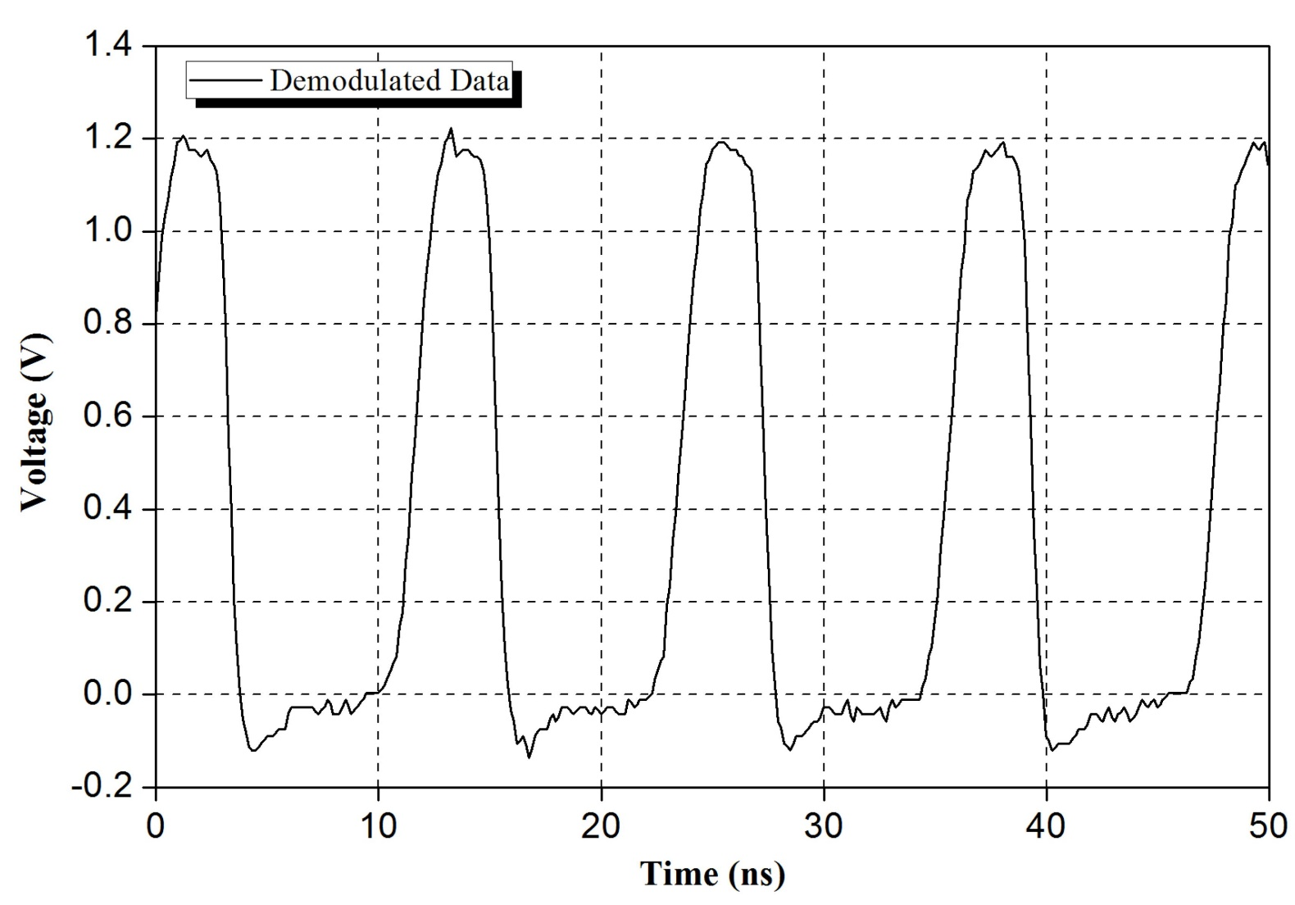
A Millimeter-Wave RFID Tag IC
Measured digital data after demodulation
Notes:
180 Mbps is measured

Slide 20
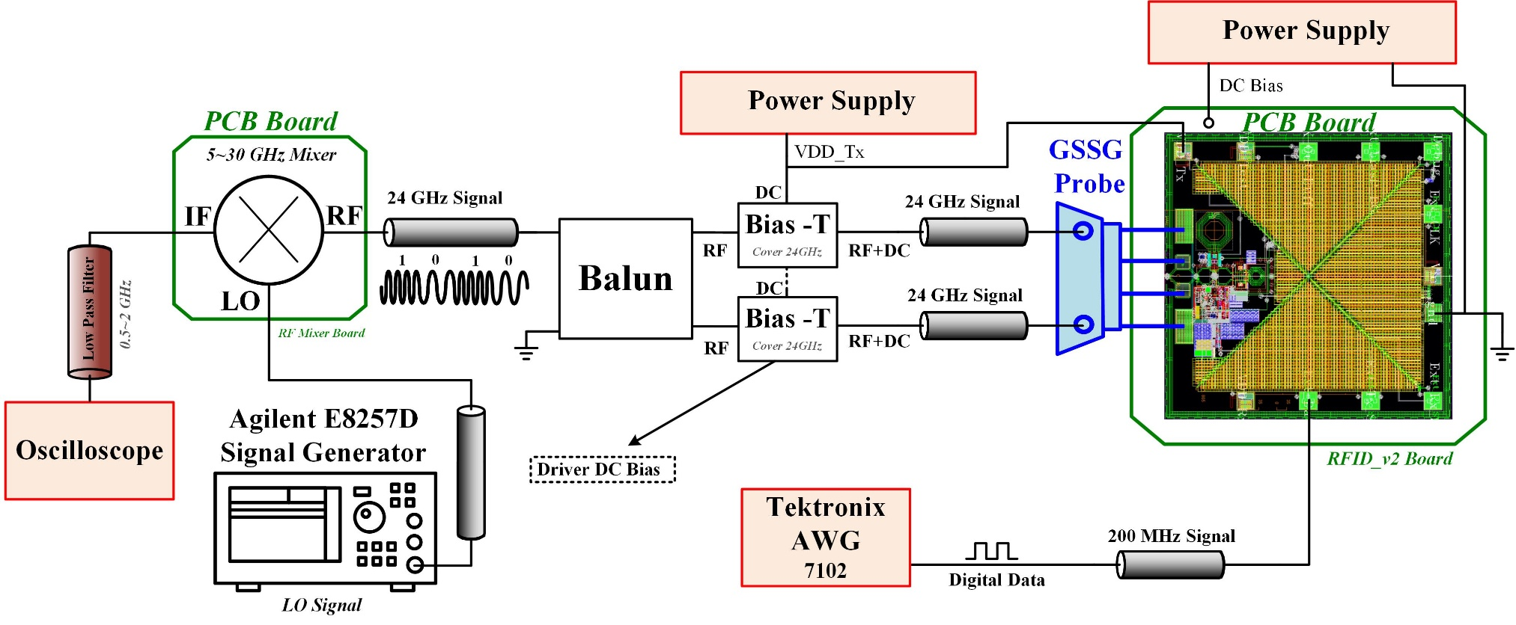
A Millimeter-Wave RFID Tag IC
Transmitter measurement setup
Down-conversion is required due to the oscilloscope limit

Slide 21
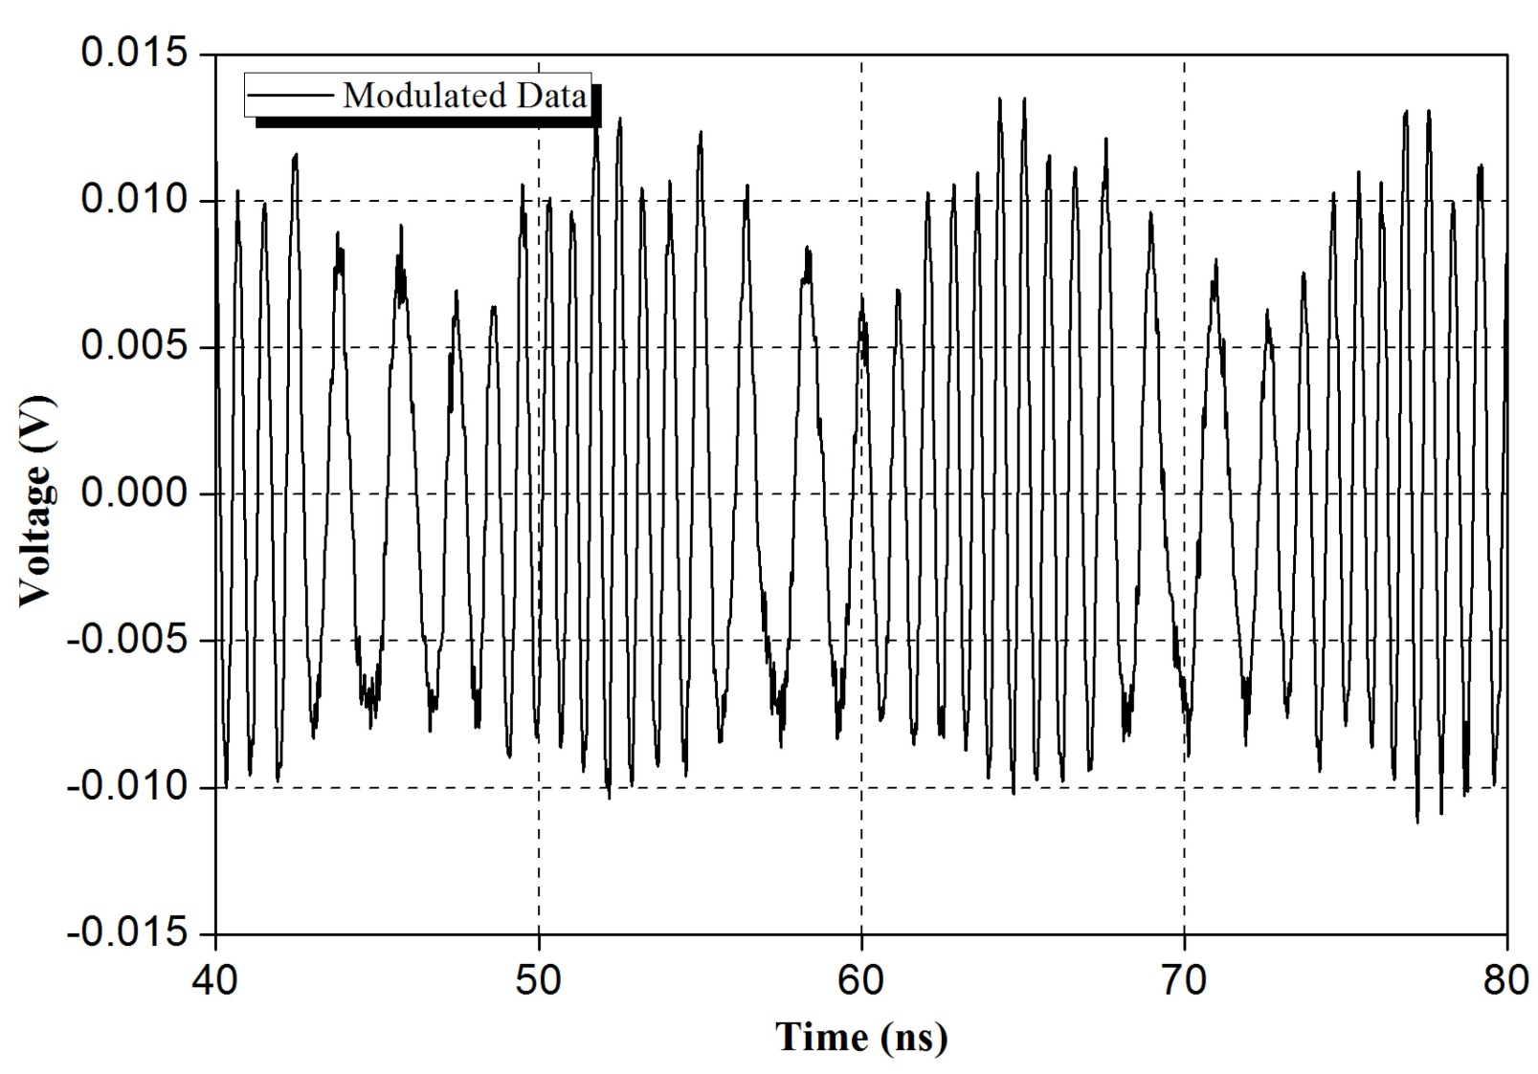
A Millimeter-Wave RFID Tag IC
Measured FSK signal
Notes:
Explain why the amplitudes are different for different frequency

Slide 22
A Millimeter-Wave In-Phase
Gate-Boosting Rectifier

Slide 23
A Millimeter-Wave IGR
The most critical block in RFID tag design: Rectifier
Rectifier converts RF power into dc supply voltage for the tag
To minimize the tag, 60 GHz is used
Parasitic capacitance degrades rectifier’s performance
As the frequency moves higher, parasitic effects impact significantly
Three rectifier design parameters
Effective threshold voltage
Forward conducting current
Reverse leakage current
An In-Phase Gate-Boosting Rectifier (IGR) is proposed to improve RF-to-dc efficiency and sensitivity

Slide 24
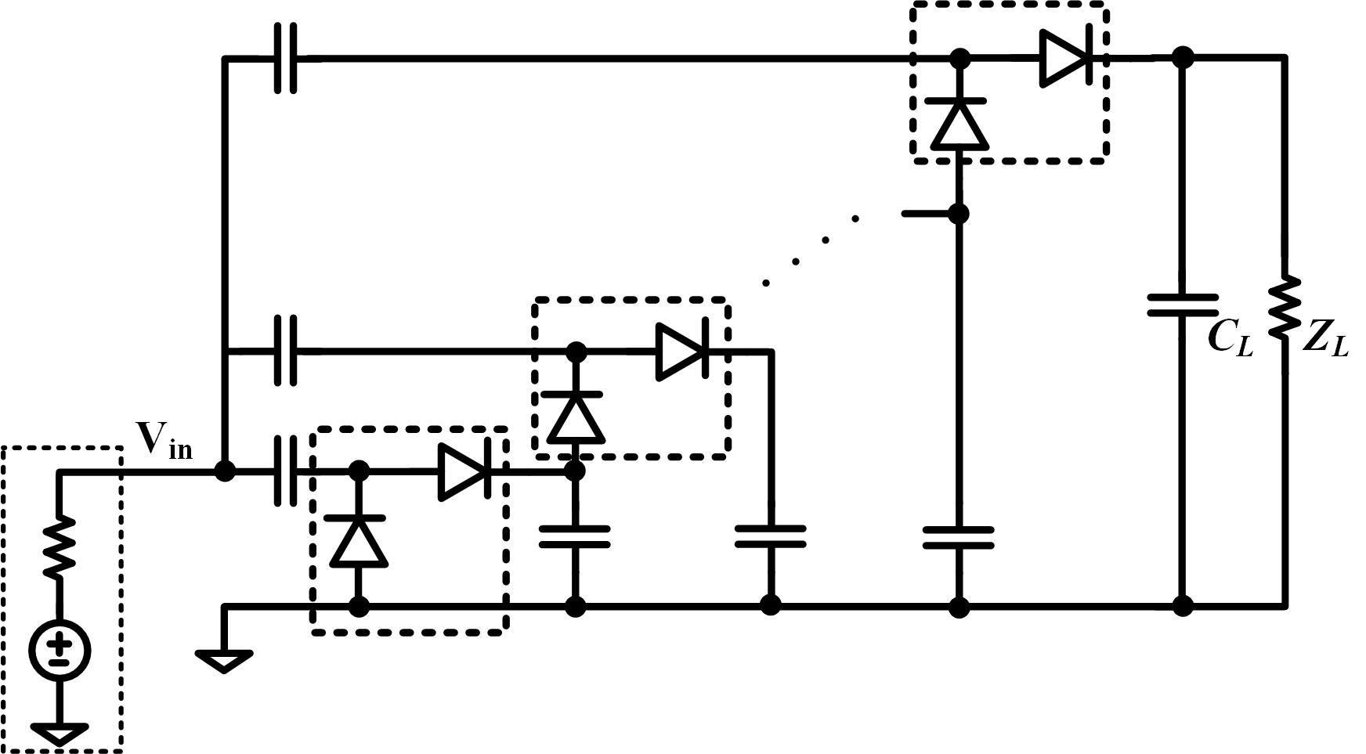
A Millimeter-Wave IGR
Basic Dickson’s rectifier architecture
Charges are pumped stage by stage

Slide 25
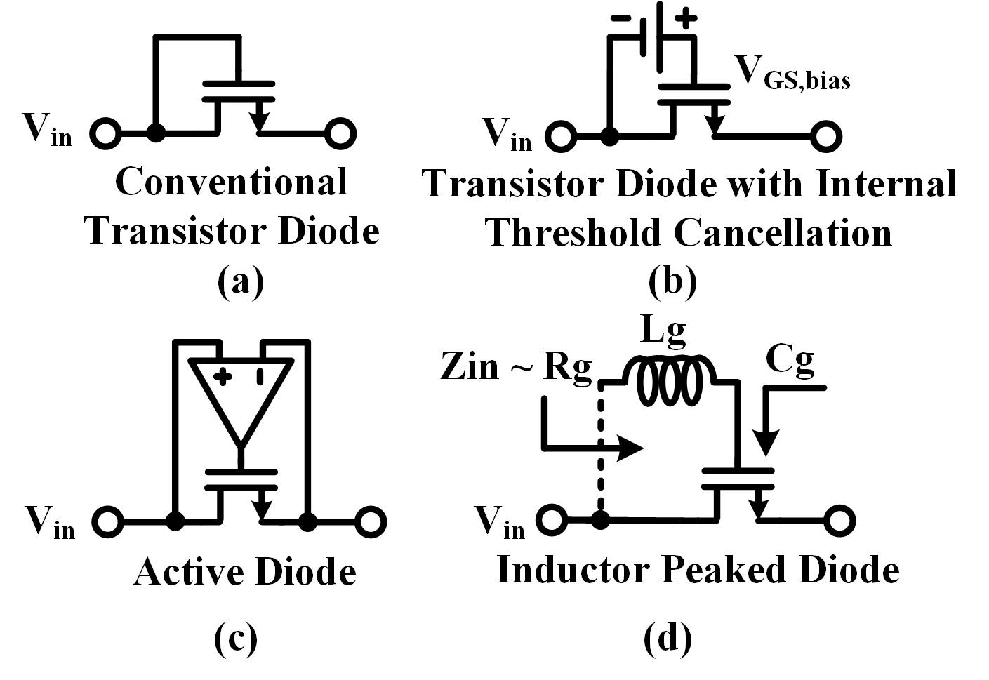
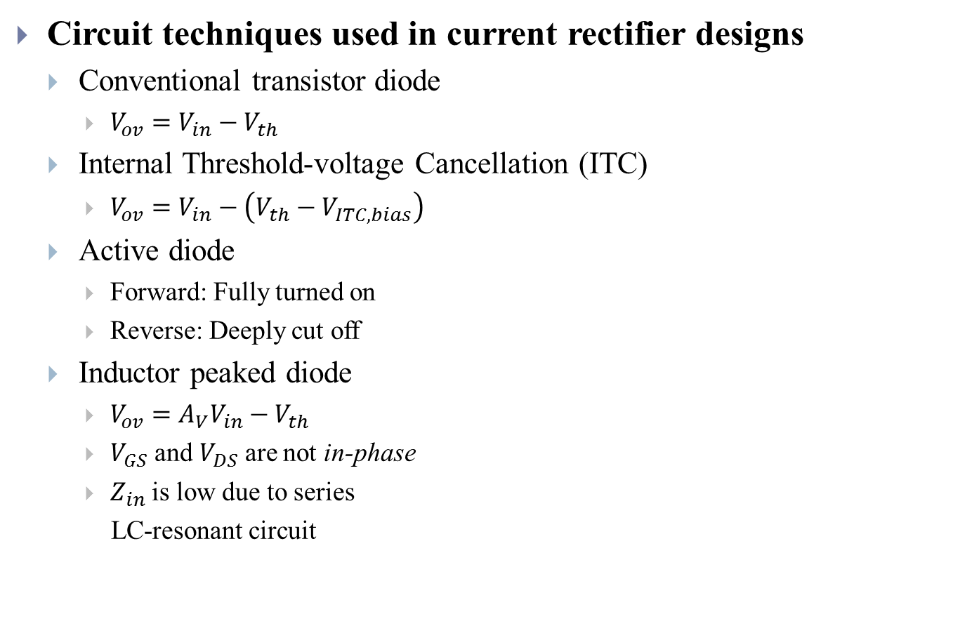
A Millimeter-Wave IGR
Circuit techniques used in current rectifier designs
Conventional transistor diode
$V_{ov}=V_{in}−V_{th}$
Internal Threshold-voltage Cancellation (ITC)
$V_{ov}=V_{in}−\left({V_{th}−V}_{ITC,bias}\right)$
Active diode
Forward: Fully turned on
Reverse: Deeply cut off
Inductor peaked diode
$V_{ov}={A_{V}V}_{in}−V_{th}$
$V_{GS}$ and $V_{DS}$ are not in-phase
$Z_{in}$ is low due to series
LC-resonant circuit
Notes:
Conventional: Vin must be larger than Vth
ITC: Startup problem
Active diode: High speed problem
Inductor peaked: No in-phase is introduced and series LC-resonant

Slide 26
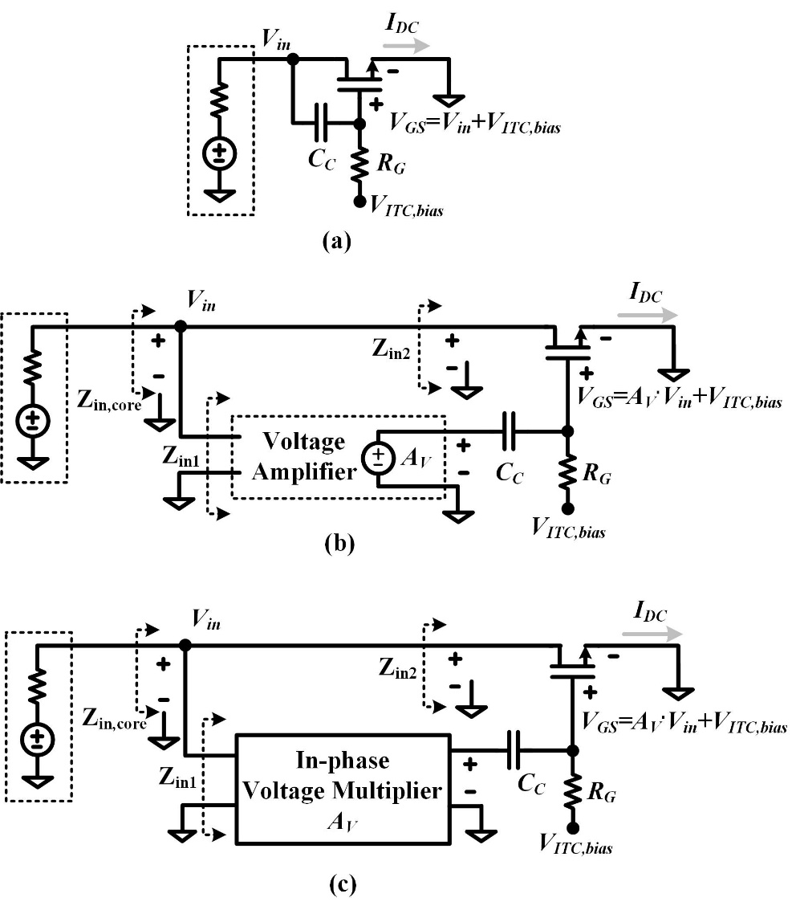
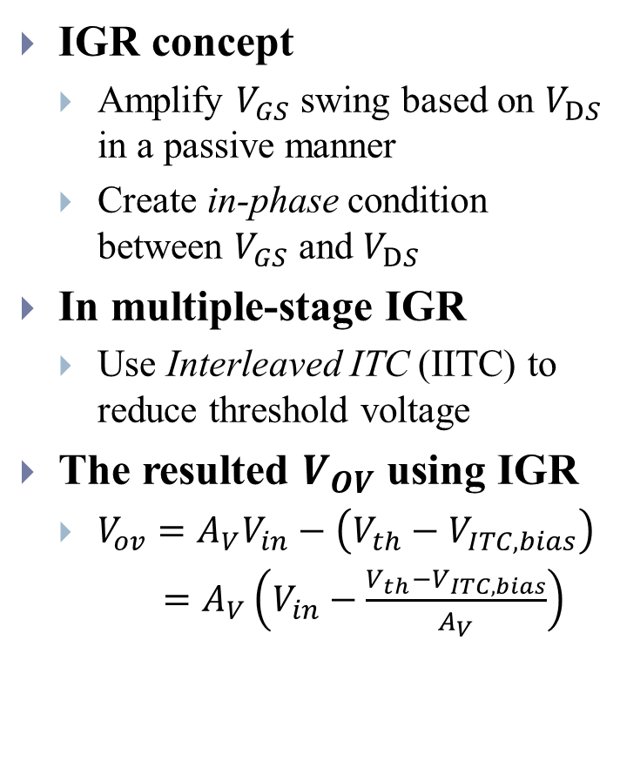
A Millimeter-Wave IGR
IGR concept
Amplify $V_{GS}$ swing based on $V_{DS}$ in a passive manner
Create in-phase condition between $V_{GS}$ and $V_{DS}$
In multiple-stage IGR
Use Interleaved ITC (IITC) to reduce threshold voltage
The resulted $V_{OV}$ using IGR
$V_{ov}={A_{V}V}_{in}−\left({V_{th}−V}_{ITC,bias}\right)$
$=A_{V}\left(V_{in}−\frac{V_{th}−V_{ITC,bias}}{A_{V}}\right)$
Notes:
IGR evolution process
Emphasize that even if there is no ITC, IGR can still reduce Vth to Vth/Av

Slide 27
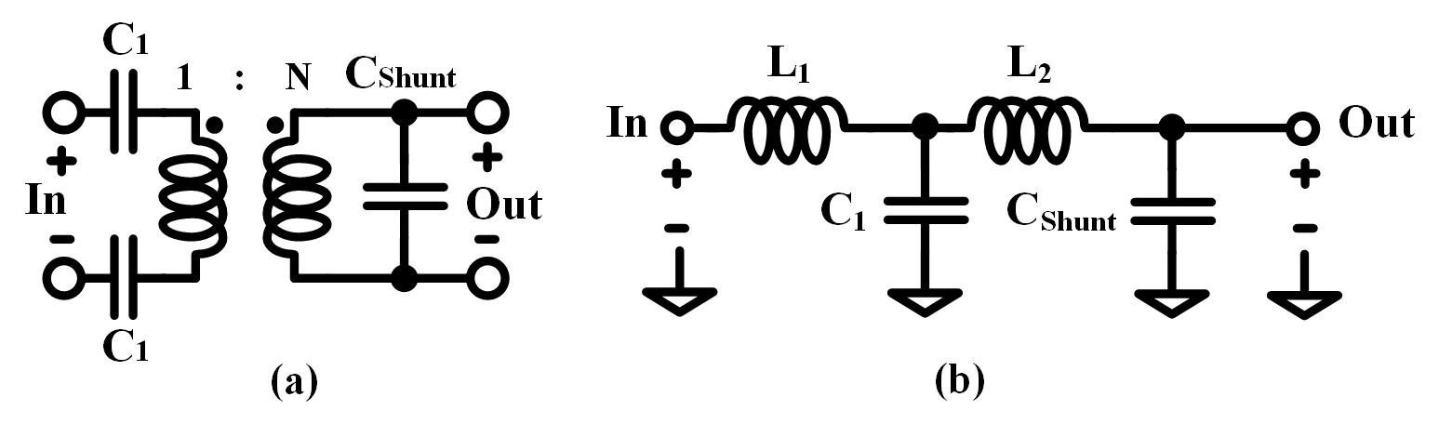
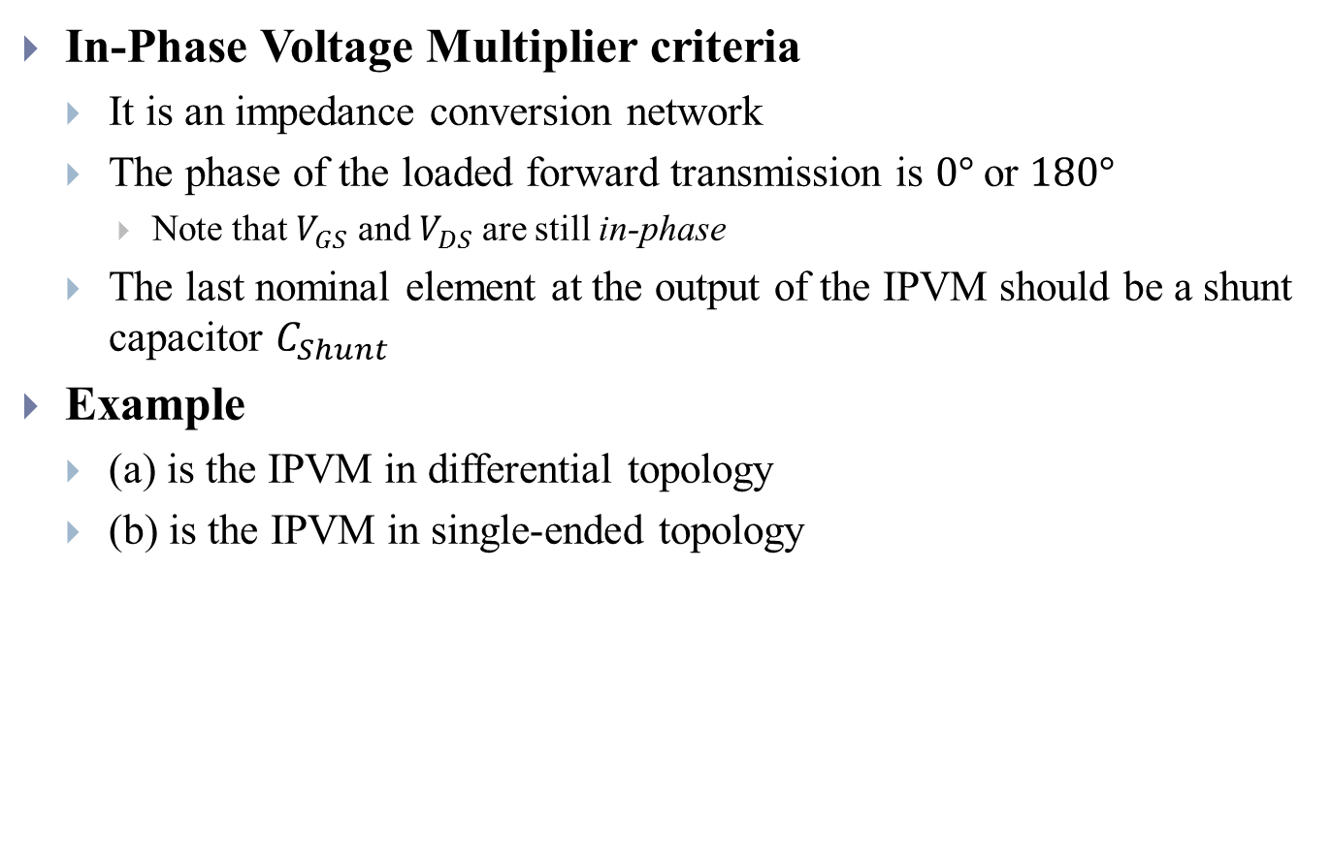
A Millimeter-Wave IGR
In-Phase Voltage Multiplier criteria
It is an impedance conversion network
The phase of the loaded forward transmission is $0°$ or $180°$
Note that $V_{GS}$ and $V_{DS}$ are still in-phase
The last nominal element at the output of the IPVM should be a shunt capacitor $C_{Shunt}$
Example
(a) is the IPVM in differential topology
(b) is the IPVM in single-ended topology
Notes:
Describe the IPVM criteria

Slide 28
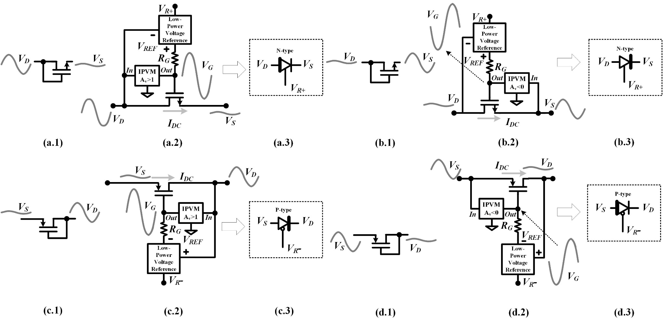
A Millimeter-Wave IGR
Single-transistor IGR
Notes:
Explain why Av>1 in (a)(c) and Av<0 in (b)(d)

Slide 29
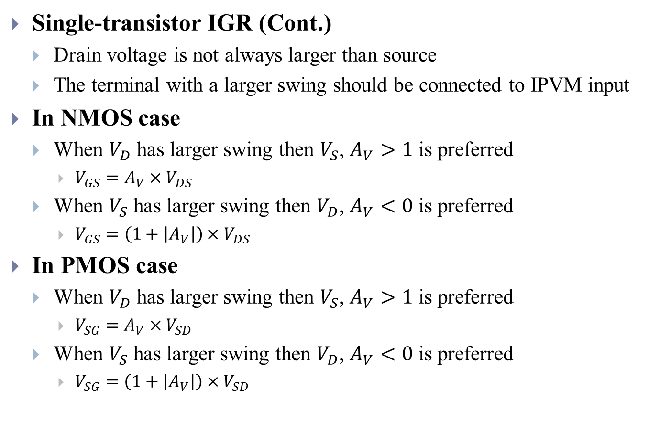
A Millimeter-Wave IGR
Single-transistor IGR (Cont.)
Drain voltage is not always larger than source
The terminal with a larger swing should be connected to IPVM input
In NMOS case
When $V_{D}$ has larger swing then $V_{S}$, $A_{V}>1$ is preferred
$V_{GS}=A_{V}×V_{DS}$
When $V_{S}$ has larger swing then $V_{D}$, $A_{V}<0$ is preferred
$V_{GS}=\left(1+\left|A_{V}\right|\right){×V}_{DS}$
In PMOS case
When $V_{D}$ has larger swing then $V_{S}$, $A_{V}>1$ is preferred
$V_{SG}=A_{V}×V_{SD}$
When $V_{S}$ has larger swing then $V_{D}$, $A_{V}<0$ is preferred
$V_{SG}=\left(1+\left|A_{V}\right|\right){×V}_{SD}$
Notes:
Explain why Av>1 in (a)(c) and Av<0 in (b)(d)

Slide 30
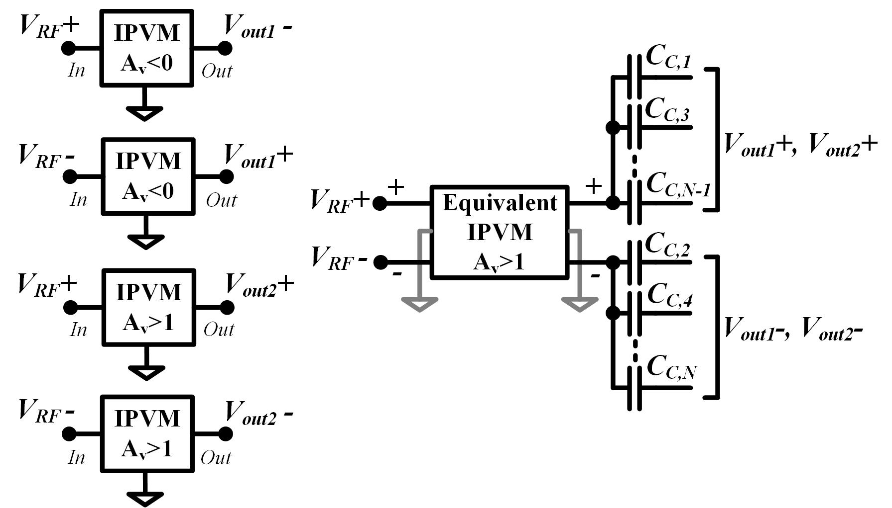
A Millimeter-Wave IGR
Multiple-transistor IGR
Each single-transistor has its own IPVM: Excessive large area
The IPVM can be combined to reduce the layout area

Slide 31
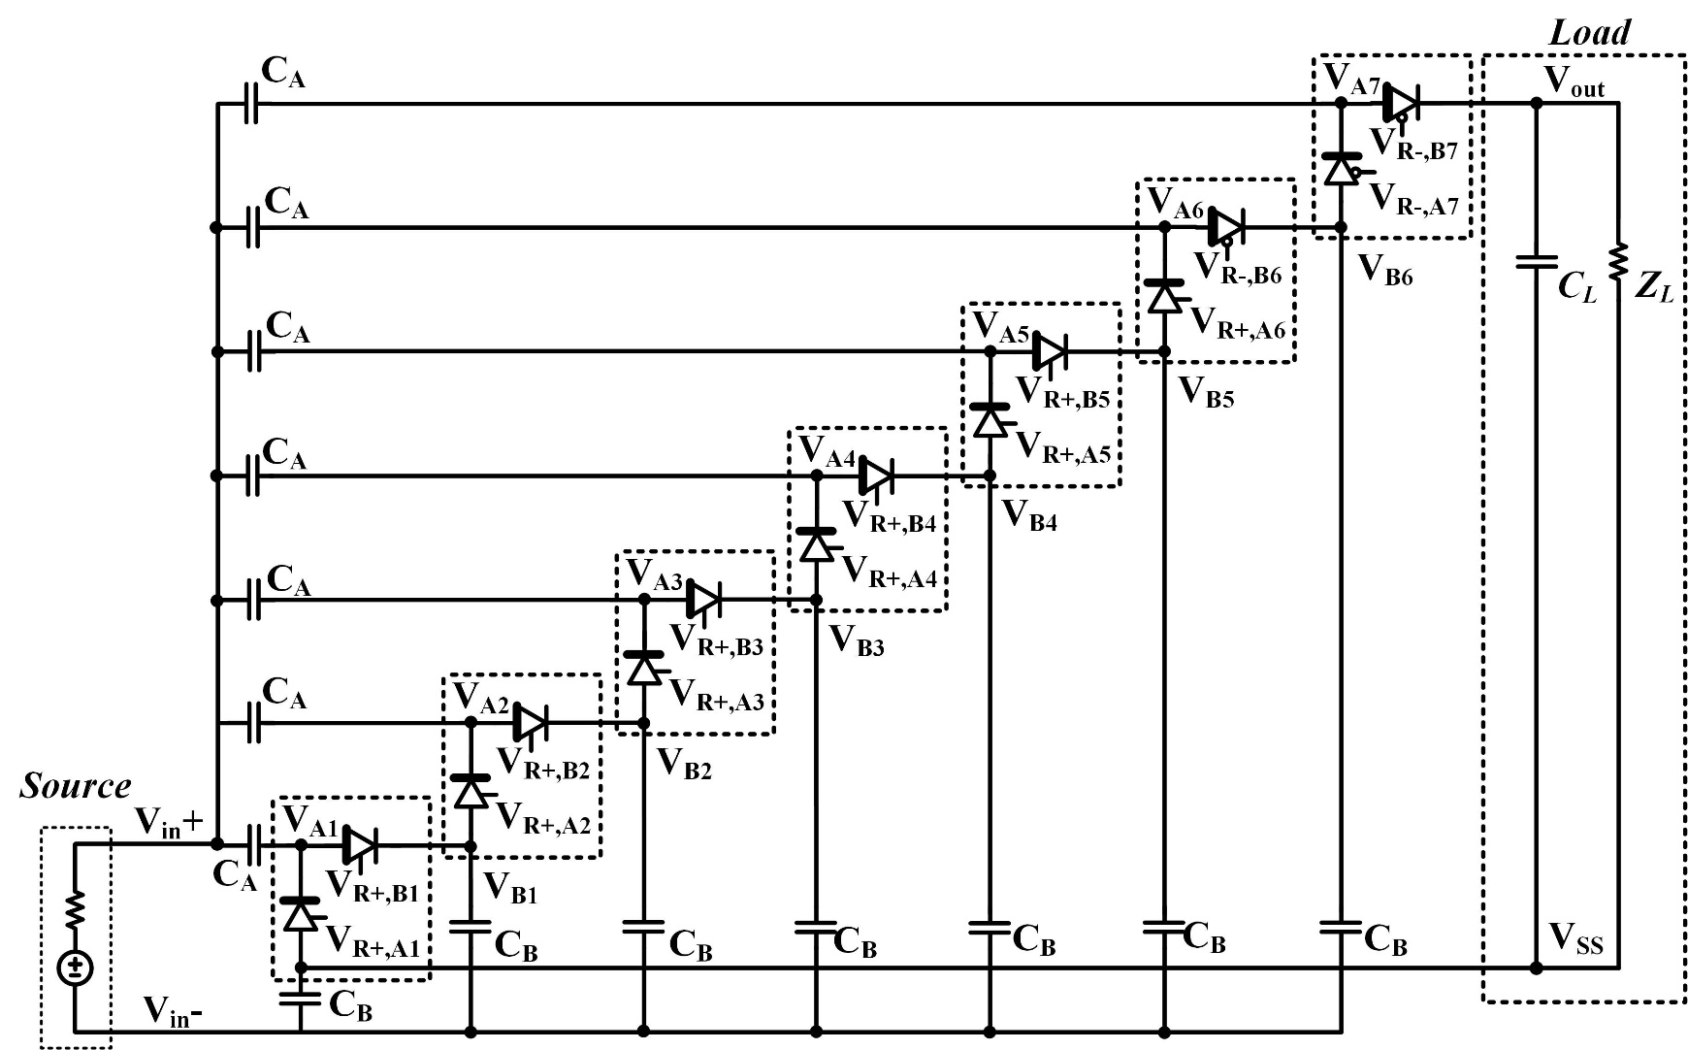
A Millimeter-Wave IGR
ITC topology in the multiple-stage rectifier

Slide 32
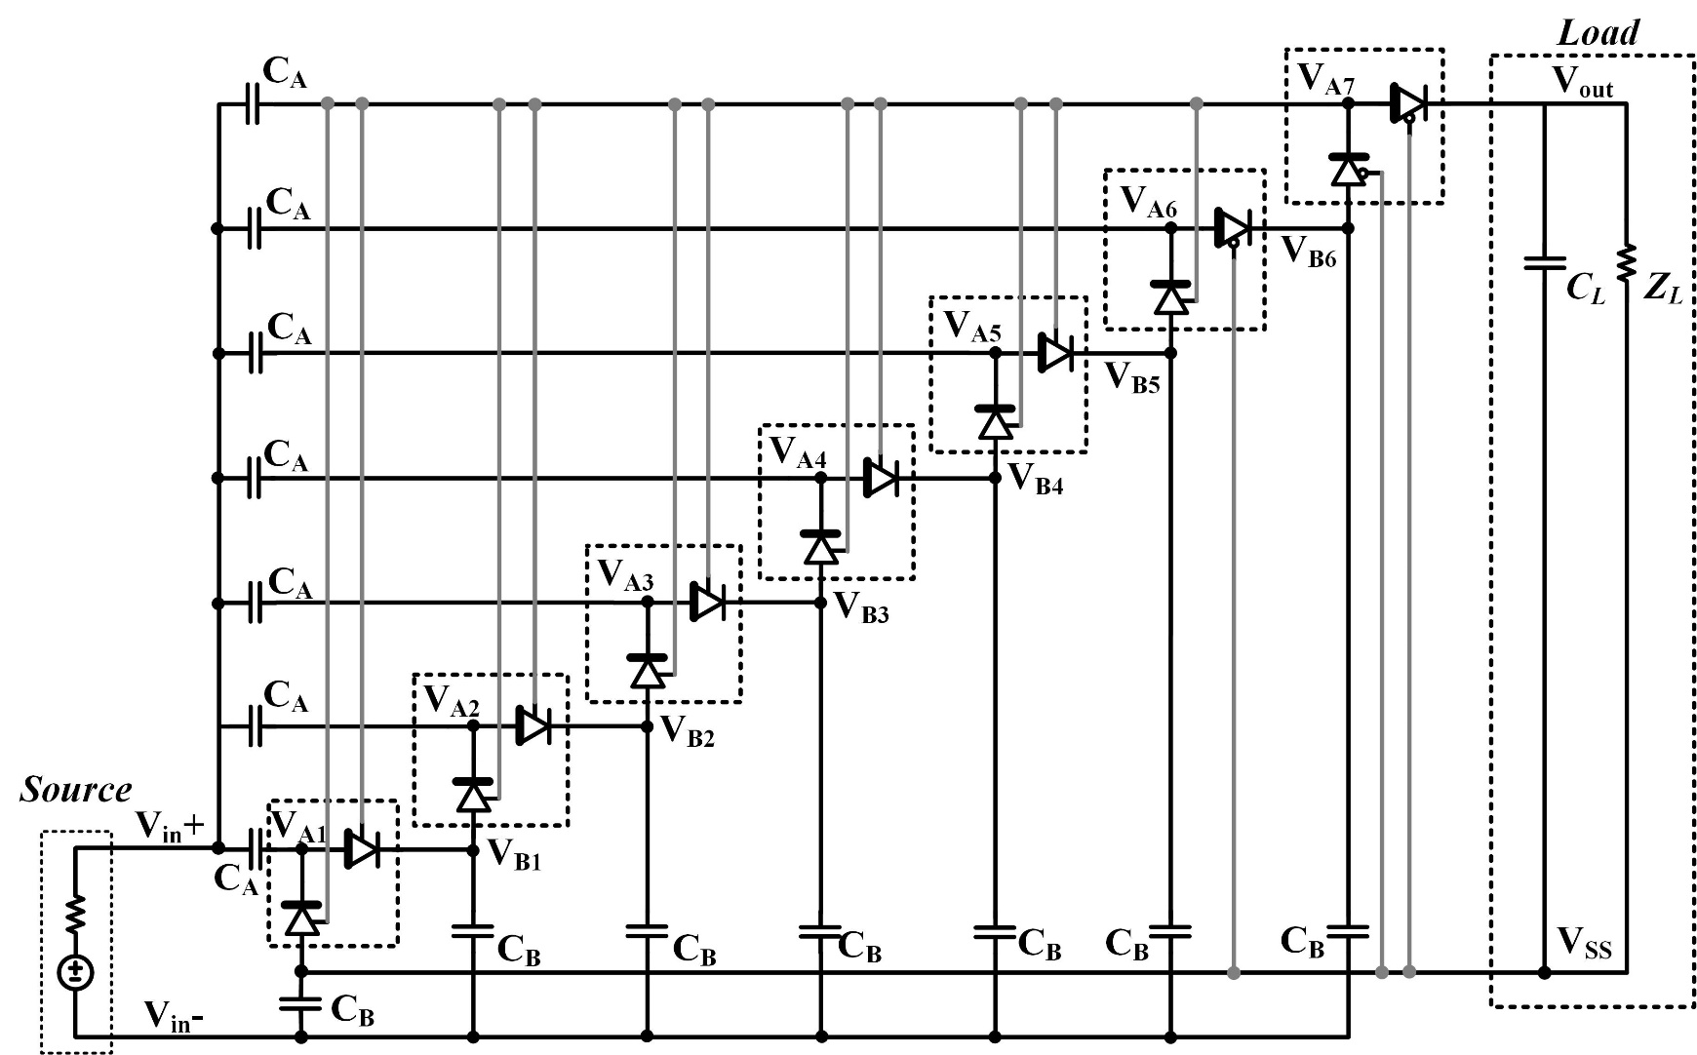
A Millimeter-Wave IGR
Conventional ITC connection

Slide 33
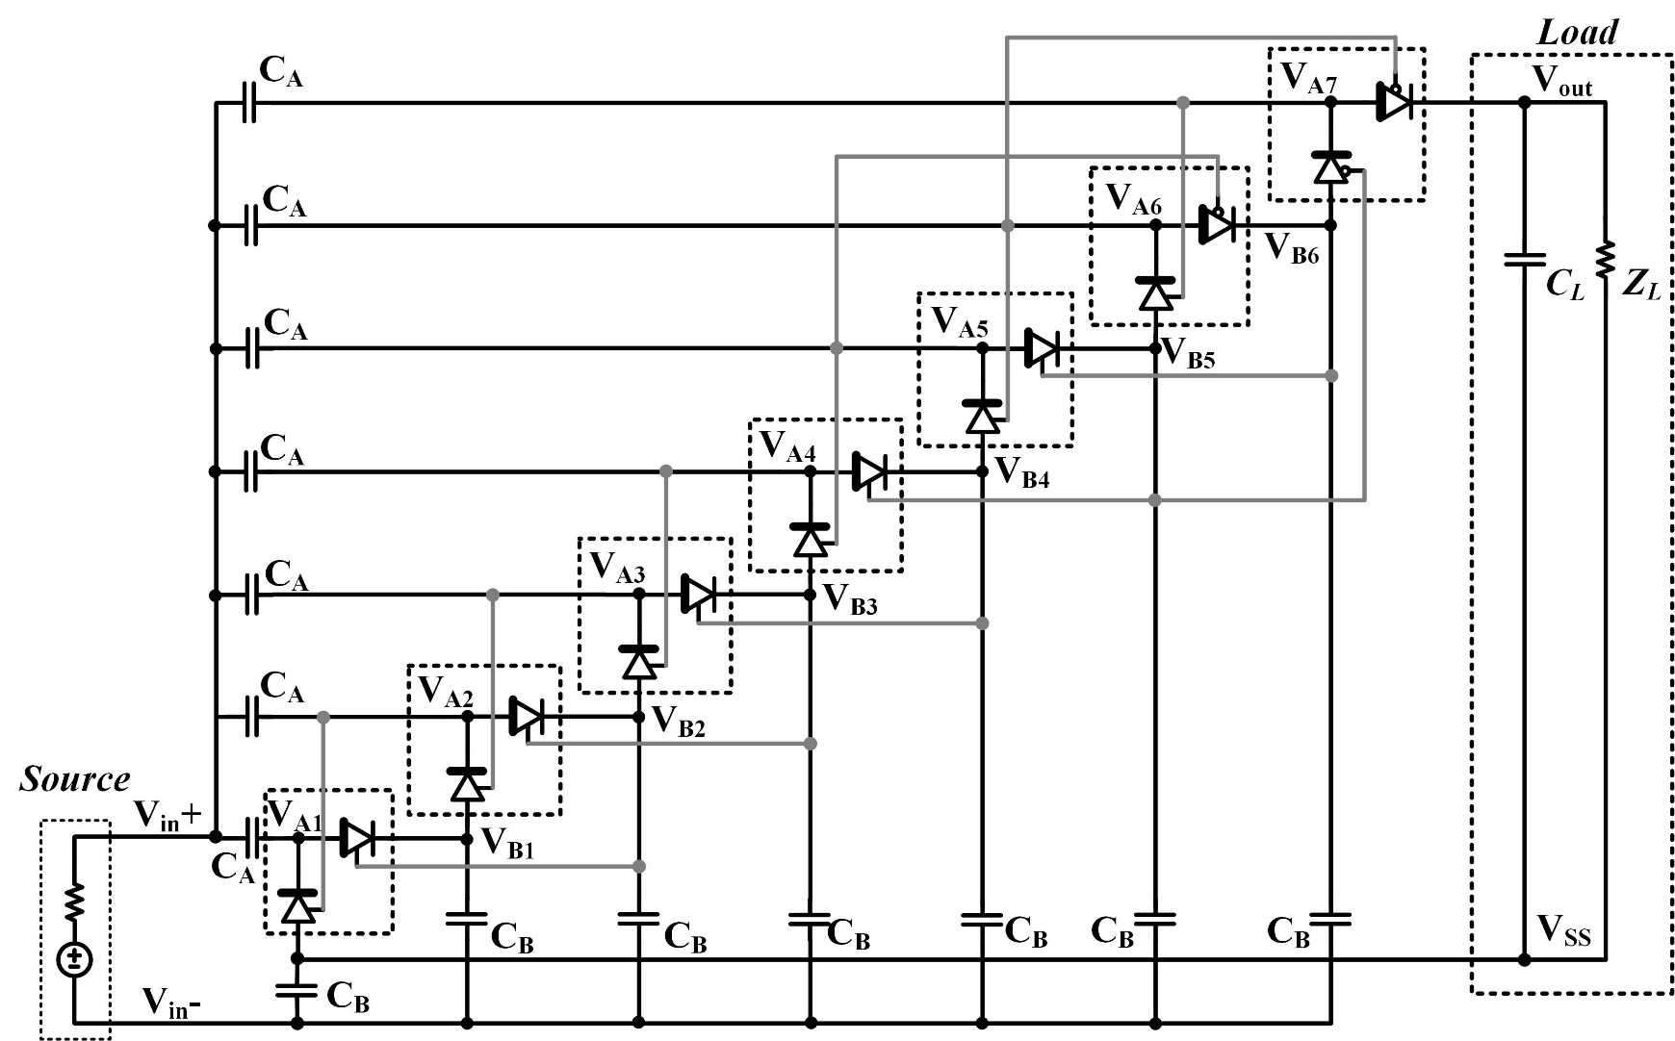
A Millimeter-Wave IGR
The proposed Interleaved ITC (IITC)

Slide 34
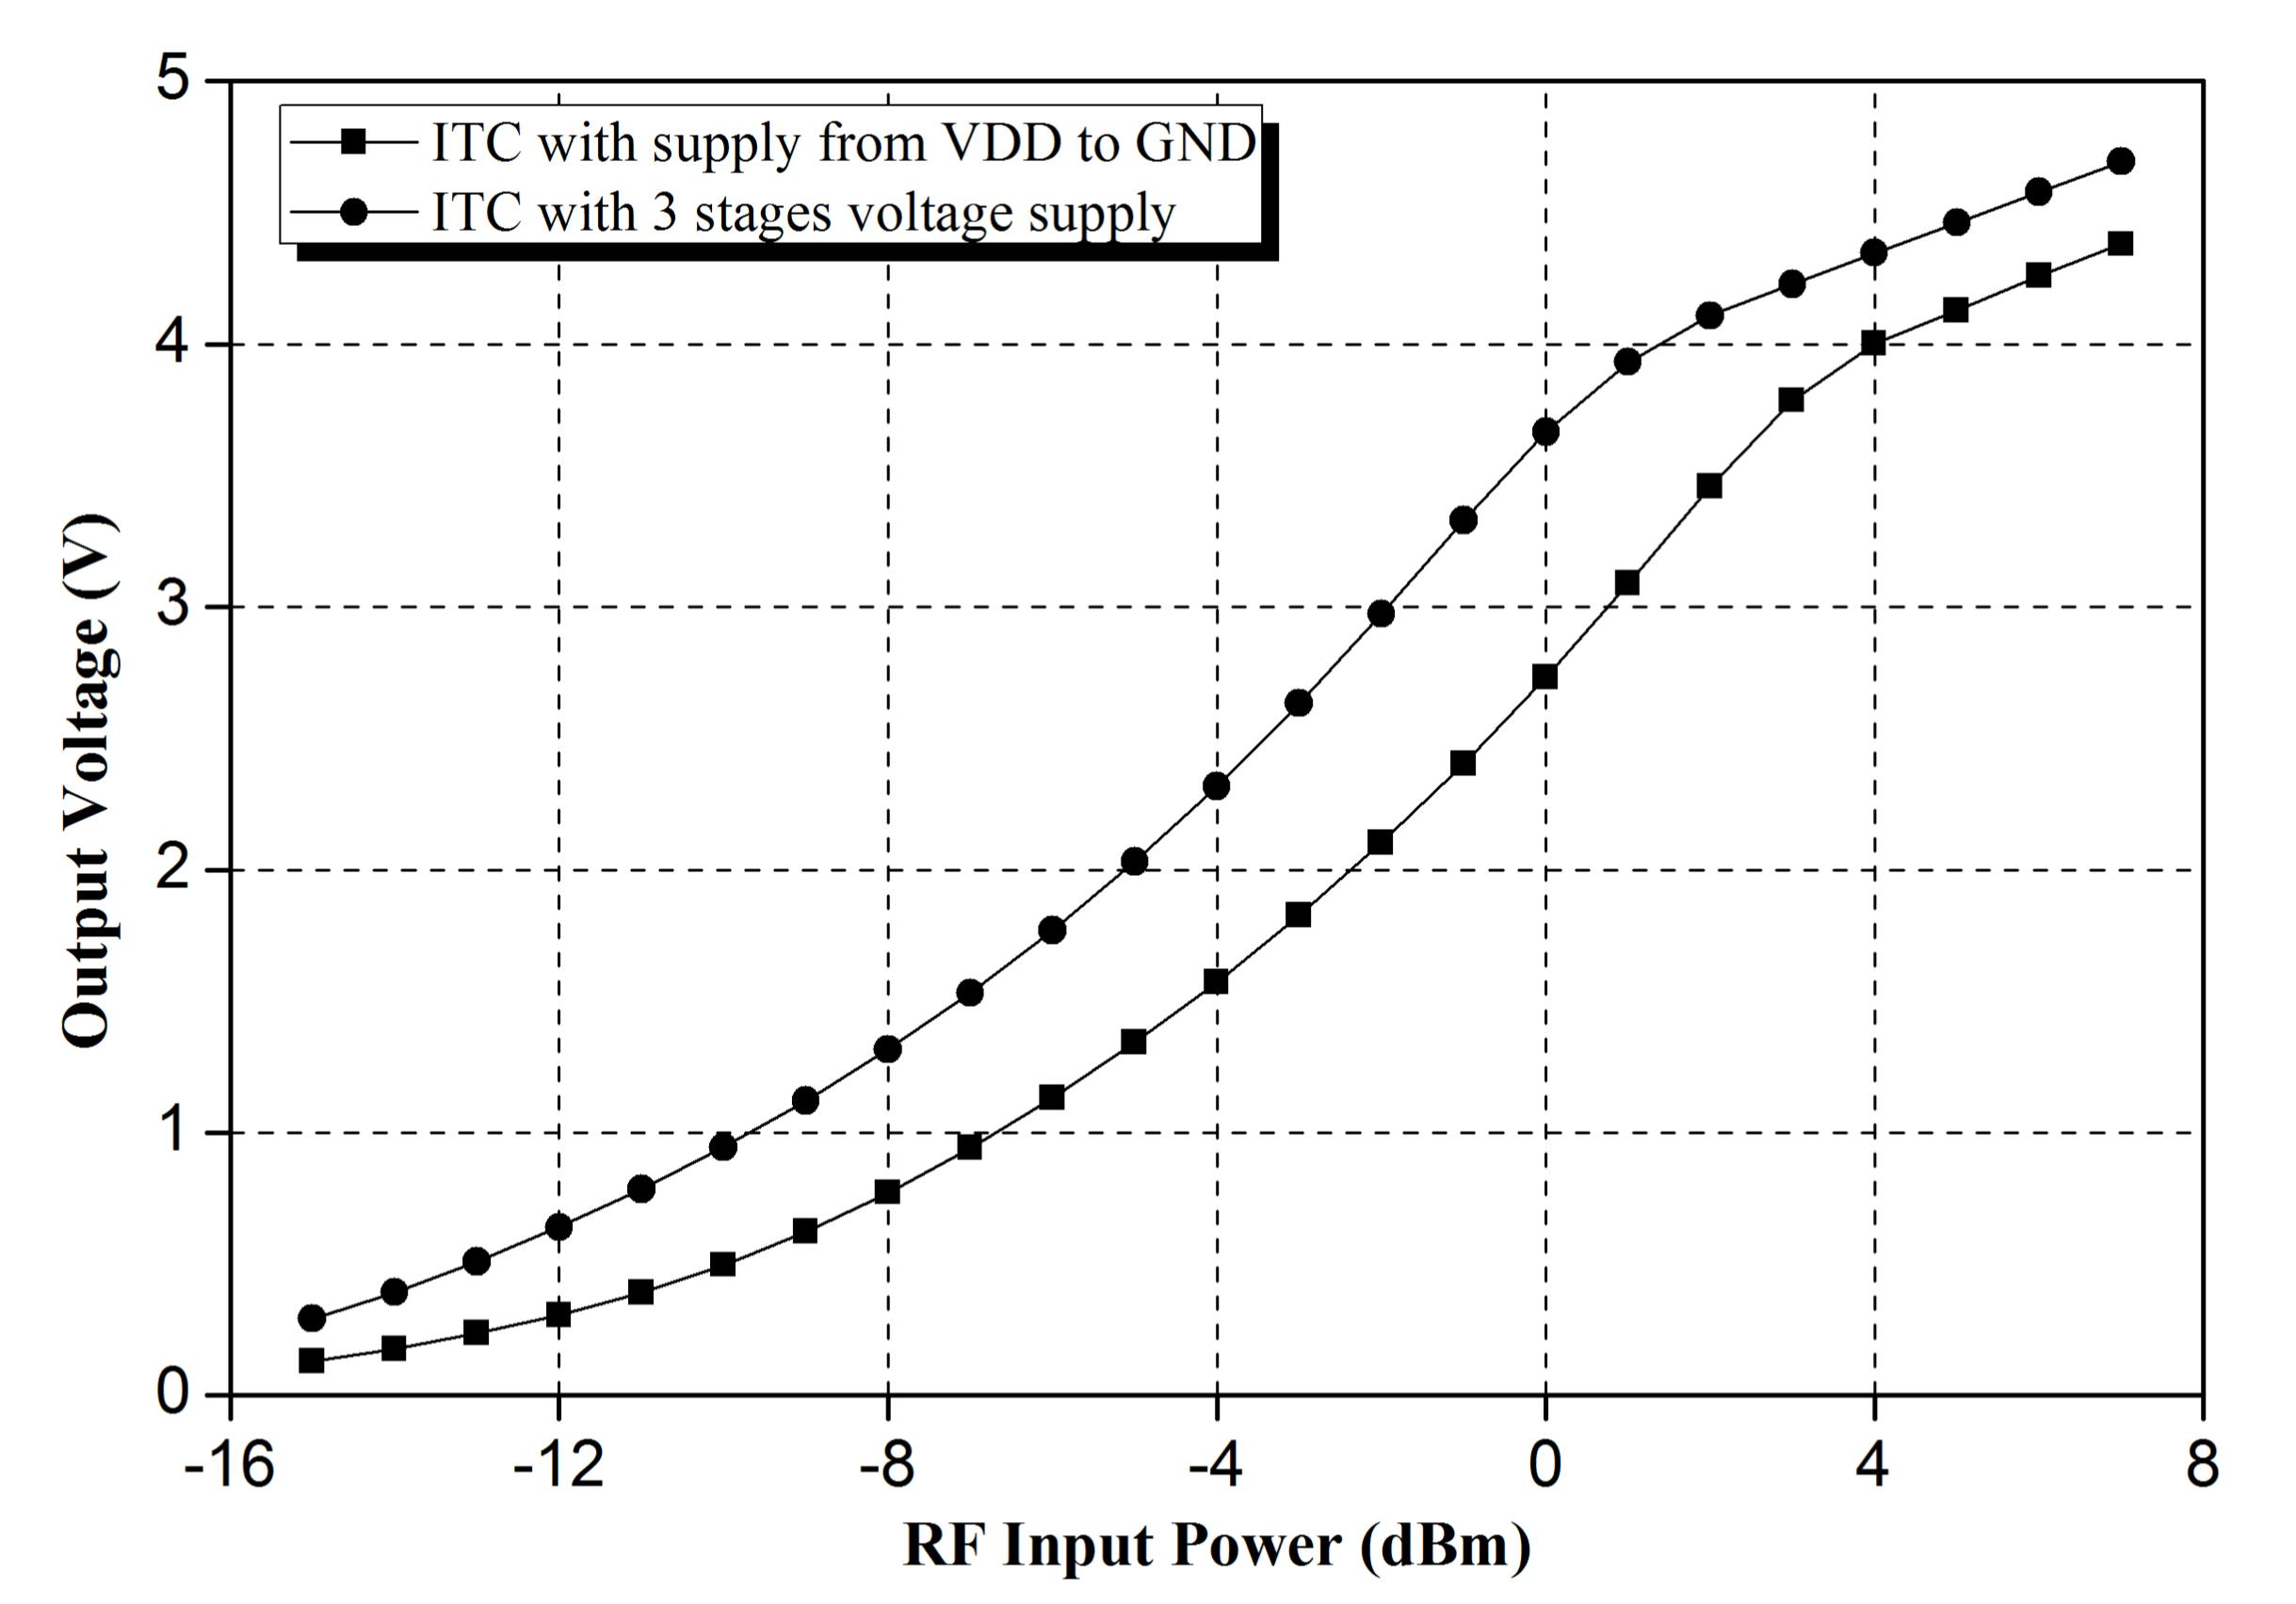
A Millimeter-Wave IGR
IITC and conventional ITC comparison
Notes:
Explain why 3-stage IITC is the best in this design

Slide 35
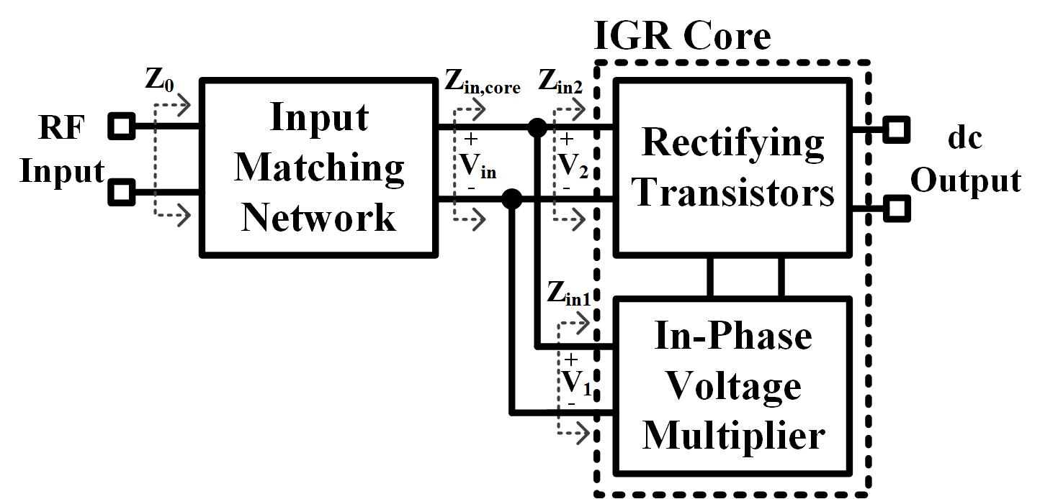

A Millimeter-Wave IGR
IGR block diagram and schematic (Schematic is on the next page)
$Z_{in,core}=Z_{in1}∥Z_{in2}$
To ensure a large voltage at the IGR core input terminal, $Z_{in,core}$ have to be large compared to $Z_{0}$

Slide 36
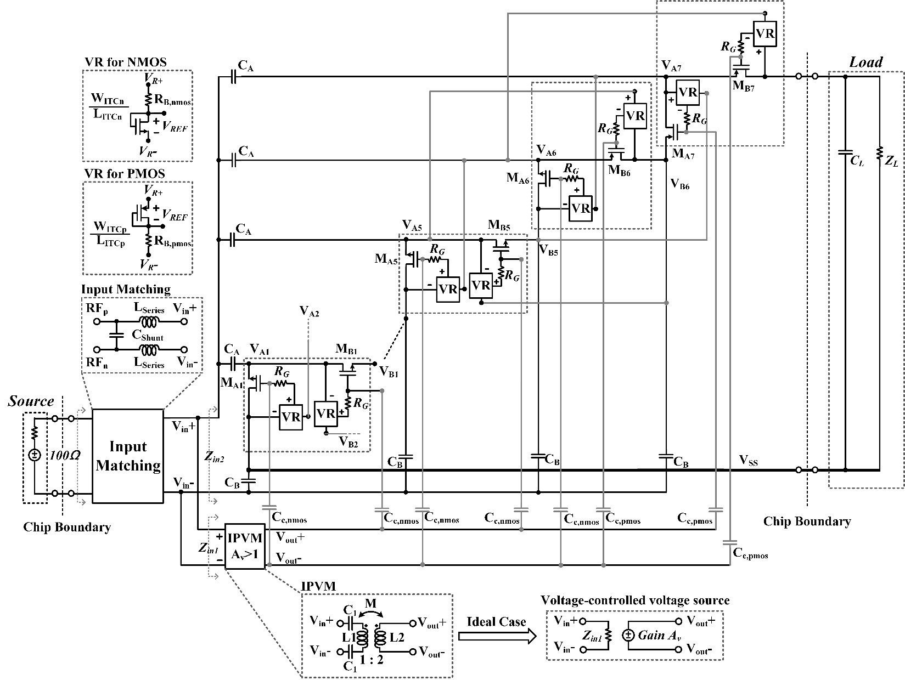
A Millimeter-Wave IGR

Slide 37
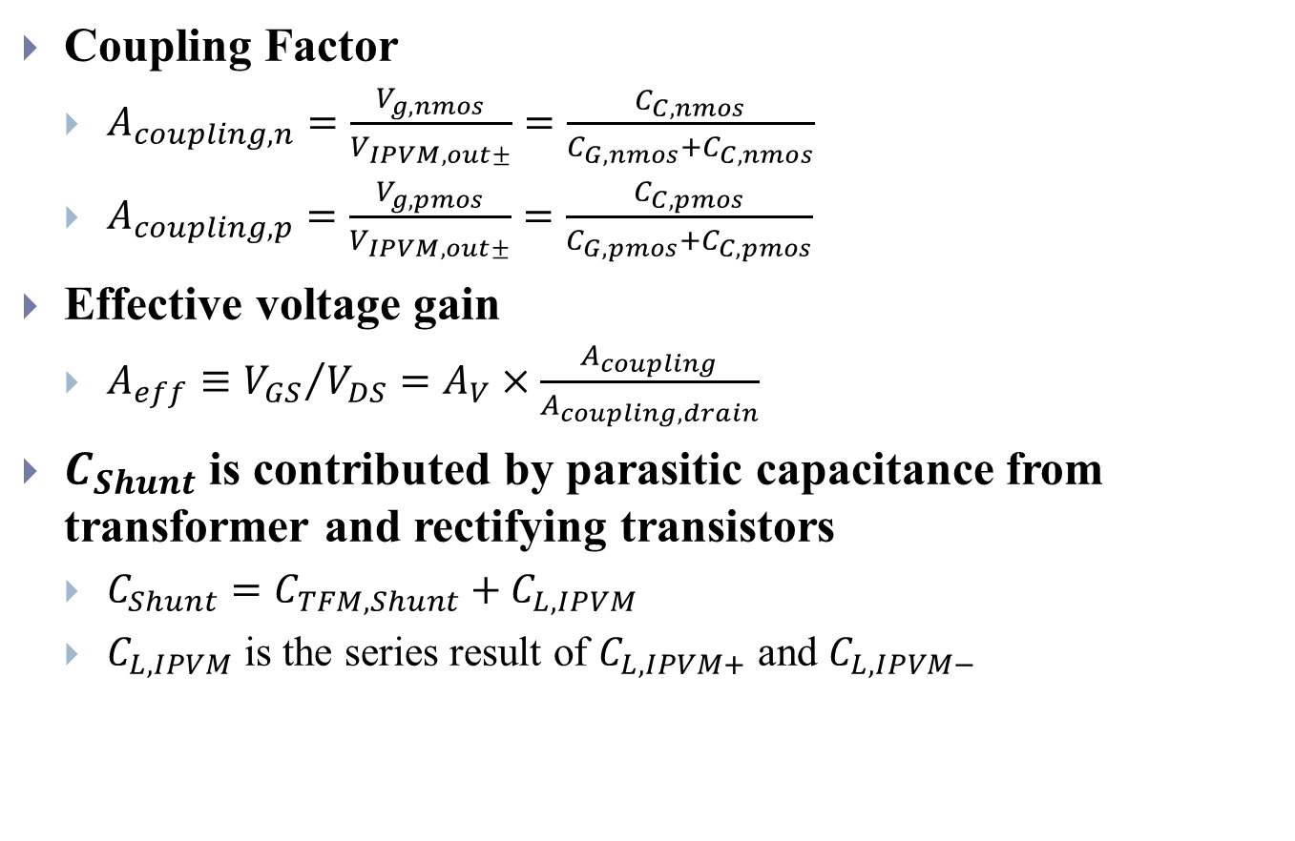
A Millimeter-Wave IGR
Coupling Factor
$A_{coupling,n}=\frac{V_{g,nmos}}{V_{IPVM,out±}}=\frac{C_{C,nmos}}{C_{G,nmos}+C_{C,nmos}}$
$A_{coupling,p}=\frac{V_{g,pmos}}{V_{IPVM,out±}}=\frac{C_{C,pmos}}{C_{G,pmos}+C_{C,pmos}}$
Effective voltage gain
$A_{eff}≡{V_{GS}}/{V_{DS}}=A_{V}×\frac{A_{coupling}}{A_{coupling,drain}}$
$C_{Shunt}$ is contributed by parasitic capacitance from transformer and rectifying transistors
$C_{Shunt}=C_{TFM,Shunt}+C_{L,IPVM}$
$C_{L,IPVM}$ is the series result of $C_{L,IPVM+}$ and $C_{L,IPVM−}$

Slide 38
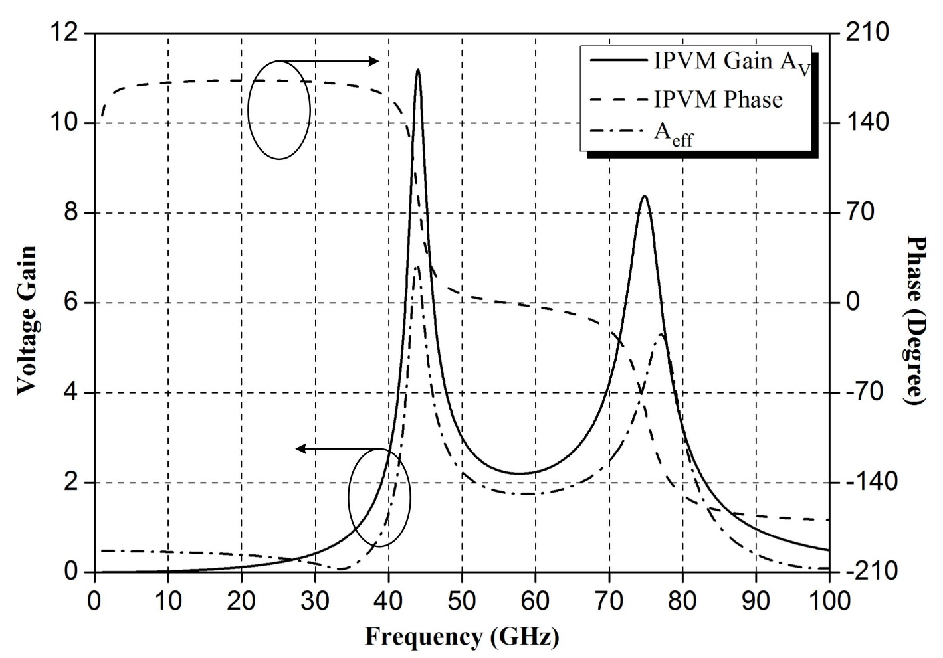
A Millimeter-Wave IGR
AC simulation result of IPVM
Notes:
Explain the bandwidth of 52-62 GHz
Describe that ±4 degrees is alright due to a larger voltage gain

Slide 39
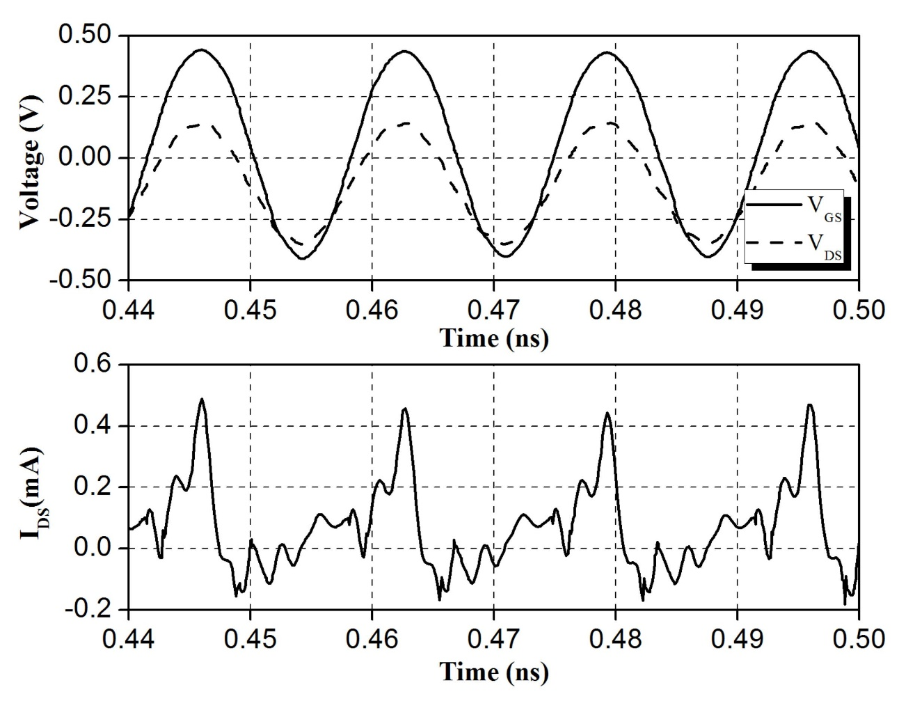

A Millimeter-Wave IGR
IGR transient simulation – In-phase (@ 60 GHz)
$V_{GS}=\left|A_{eff}\right|×V_{DS}$
Notes:
Small reverse current

Slide 40
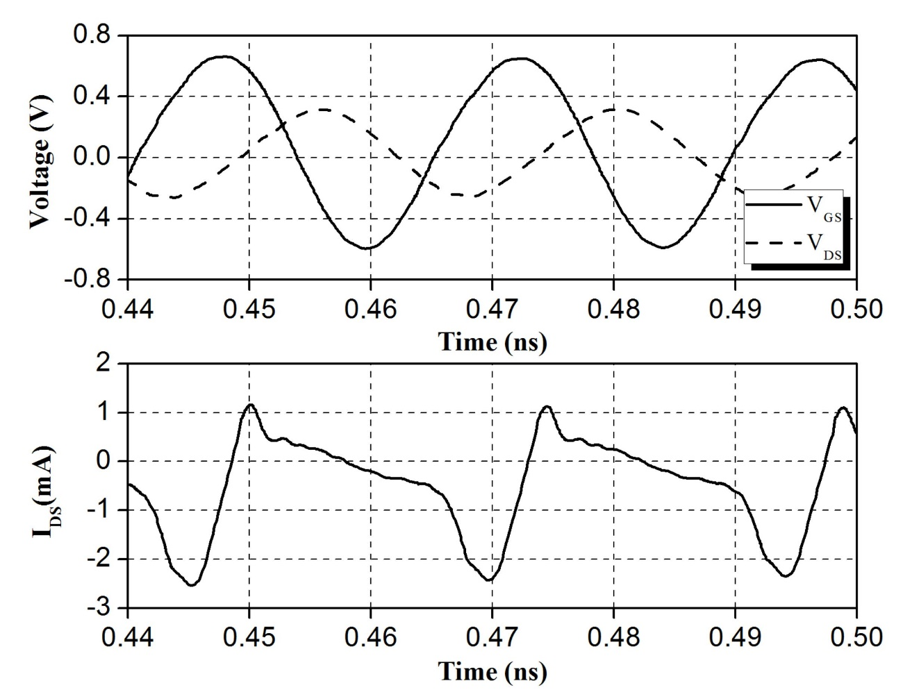

A Millimeter-Wave IGR
IGR transient simulation – Out of phase (@ 41 GHz)
$V_{GS}=\left(\left|A_{eff}\right|∠140°\right)×V_{DS}$
Notes:
Large leakage current

Slide 41
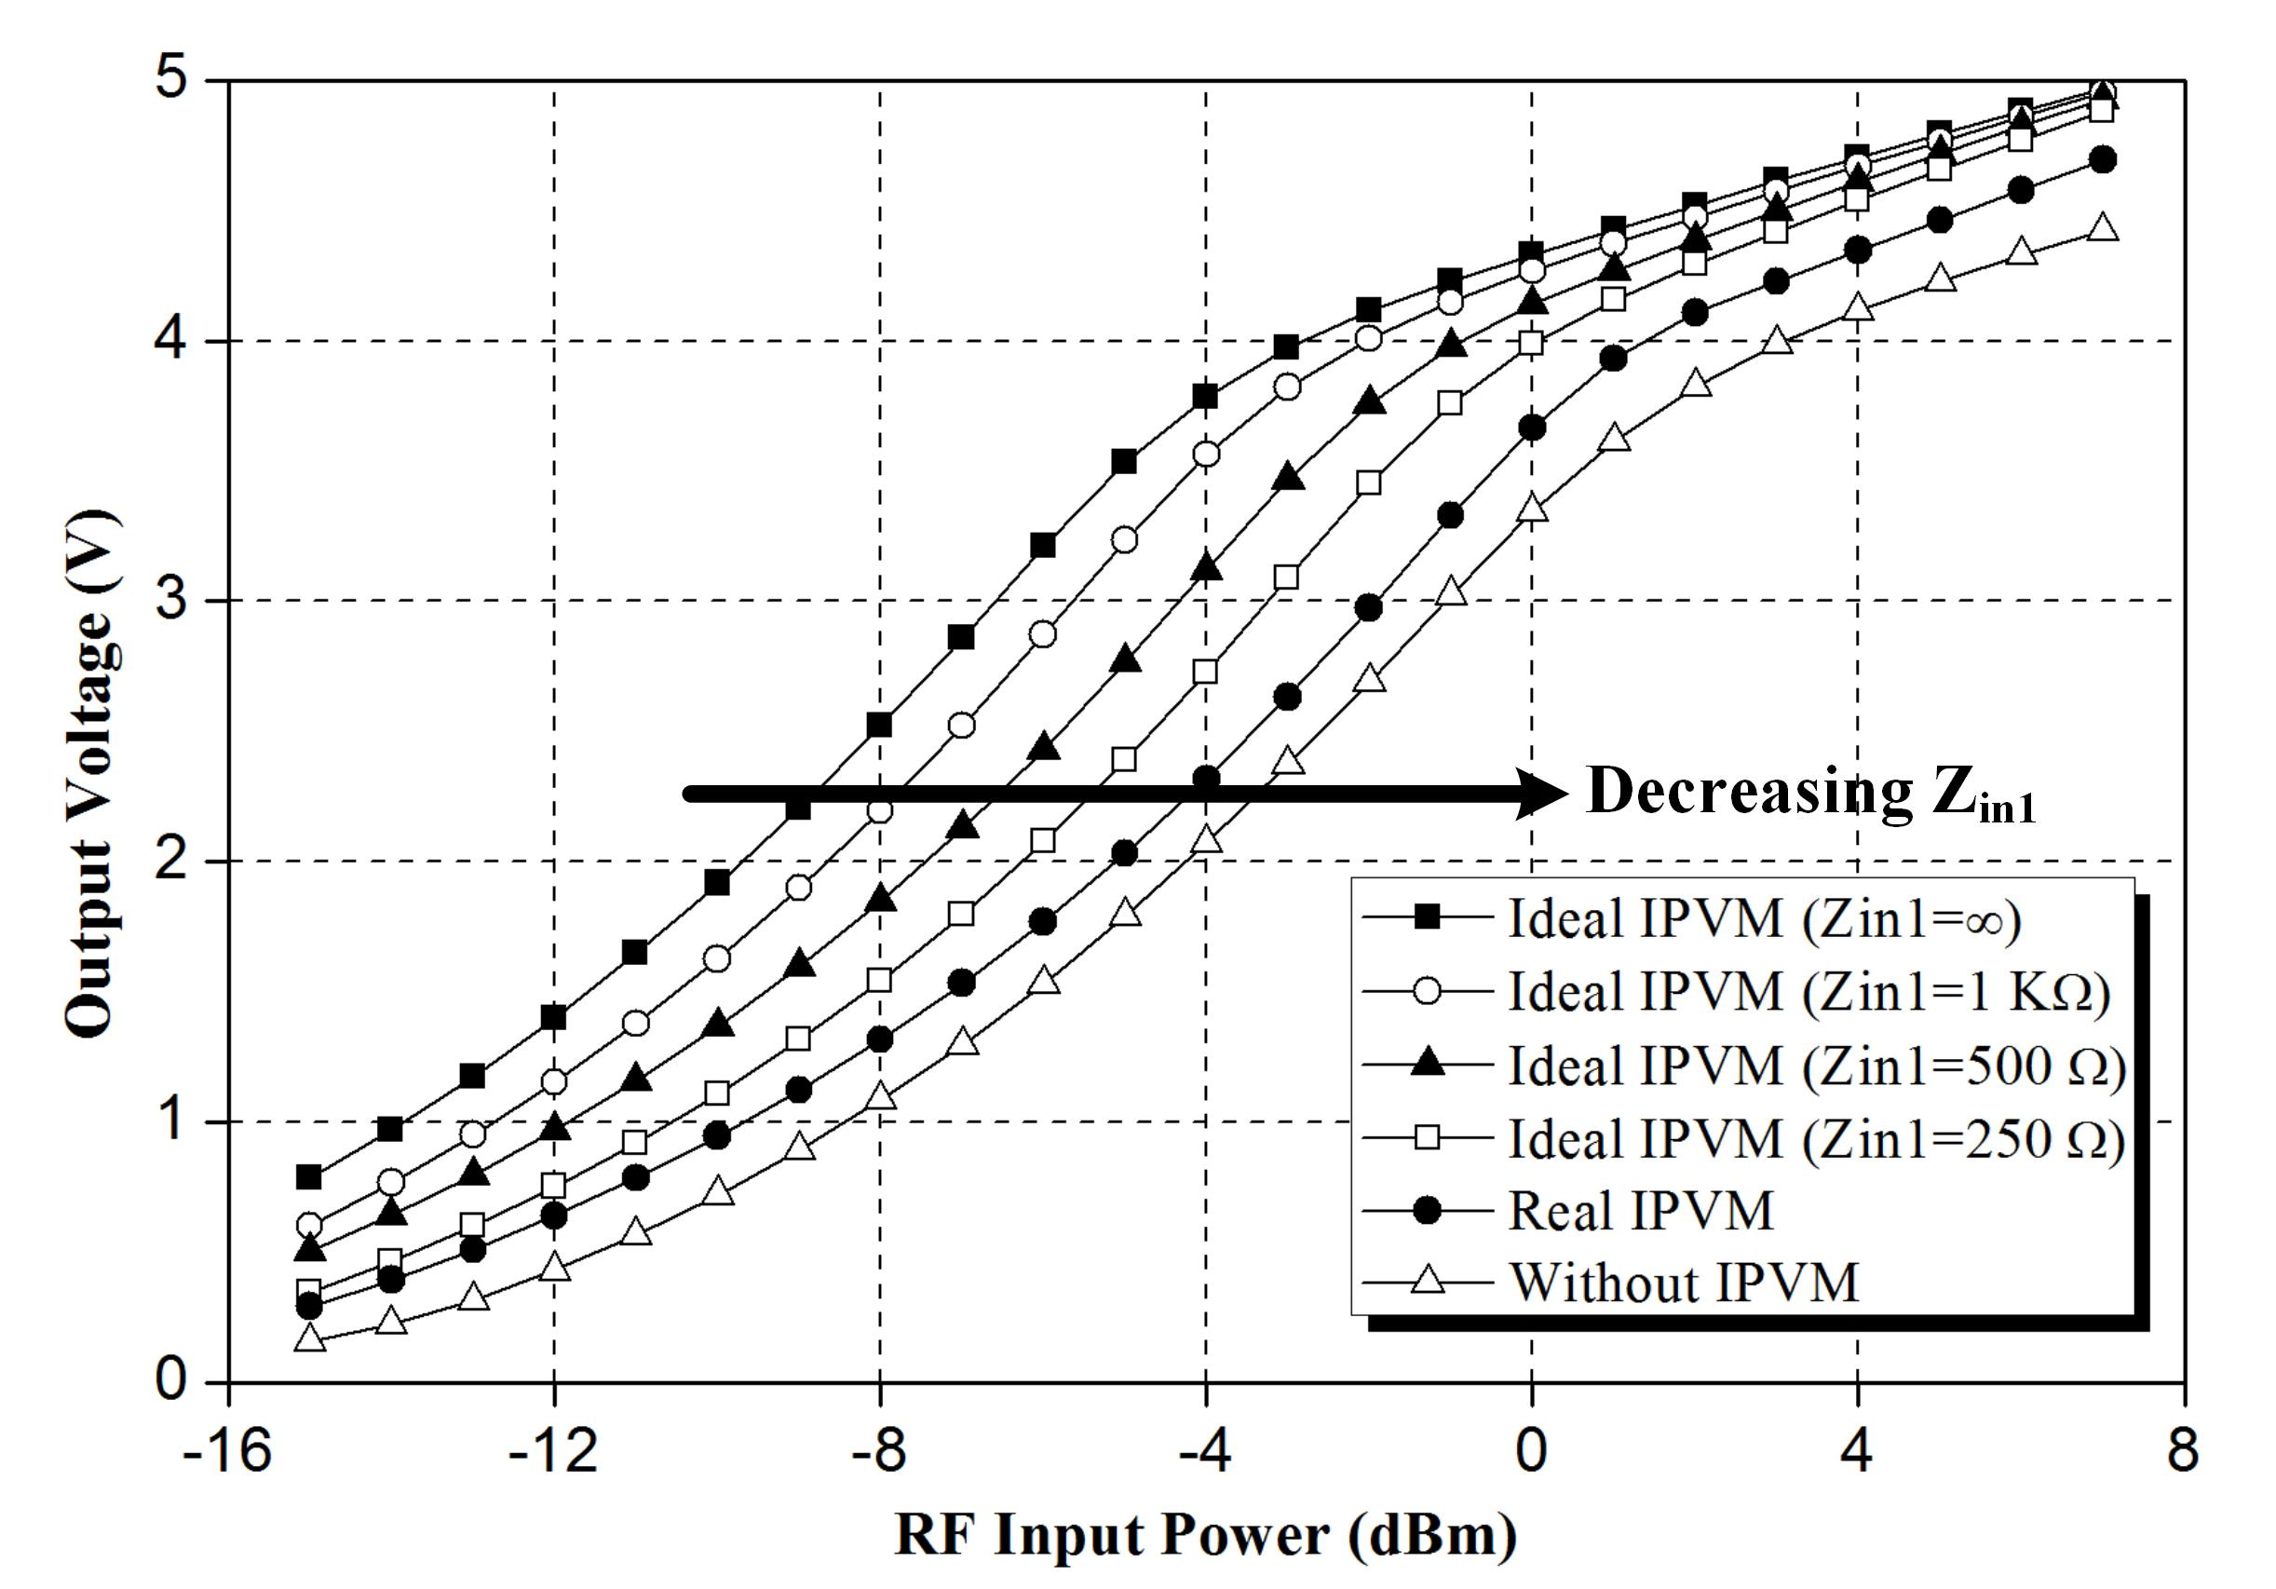
A Millimeter-Wave IGR
Potentials of the proposed IGR
Notes:
There is still a big margin to improve the proposed IGR by enlarging IGR’s input impedance (Zin1)

Slide 42
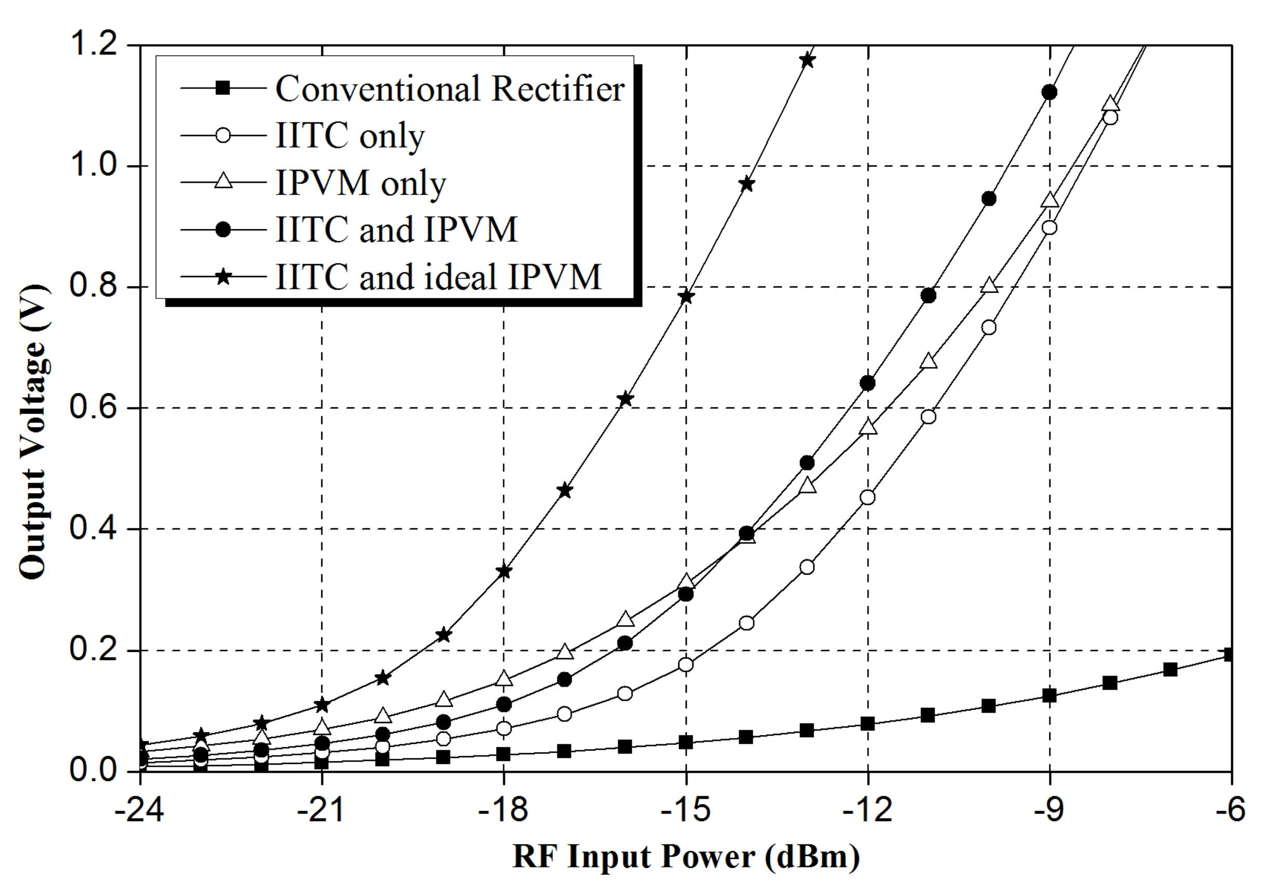
A Millimeter-Wave IGR
Comparisons among several circuit techniques
Notes:
Either IITC only or IPVM only overwhelms the conventional rectifier in the same number of stages.
IPVM only performs well in the low input power region. IPVM only is better than IITC+IPVM because IITC has the startup issue.
ITC only performs well in the high input power region.
There is still room to improve if the loss of IPVM can be reduced and Zin1 can be increased.

Slide 43
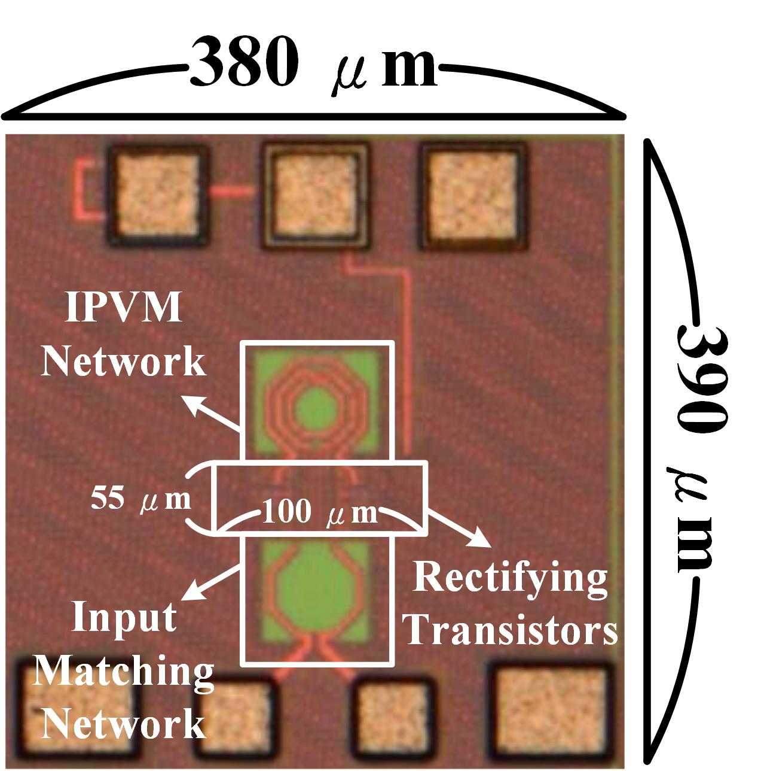
A Millimeter-Wave IGR
IGR chip micrograph
All the pads are for measurement
IPVM and Input Matching occupy most of layout area
It will be integrated in RFID tag

Slide 44
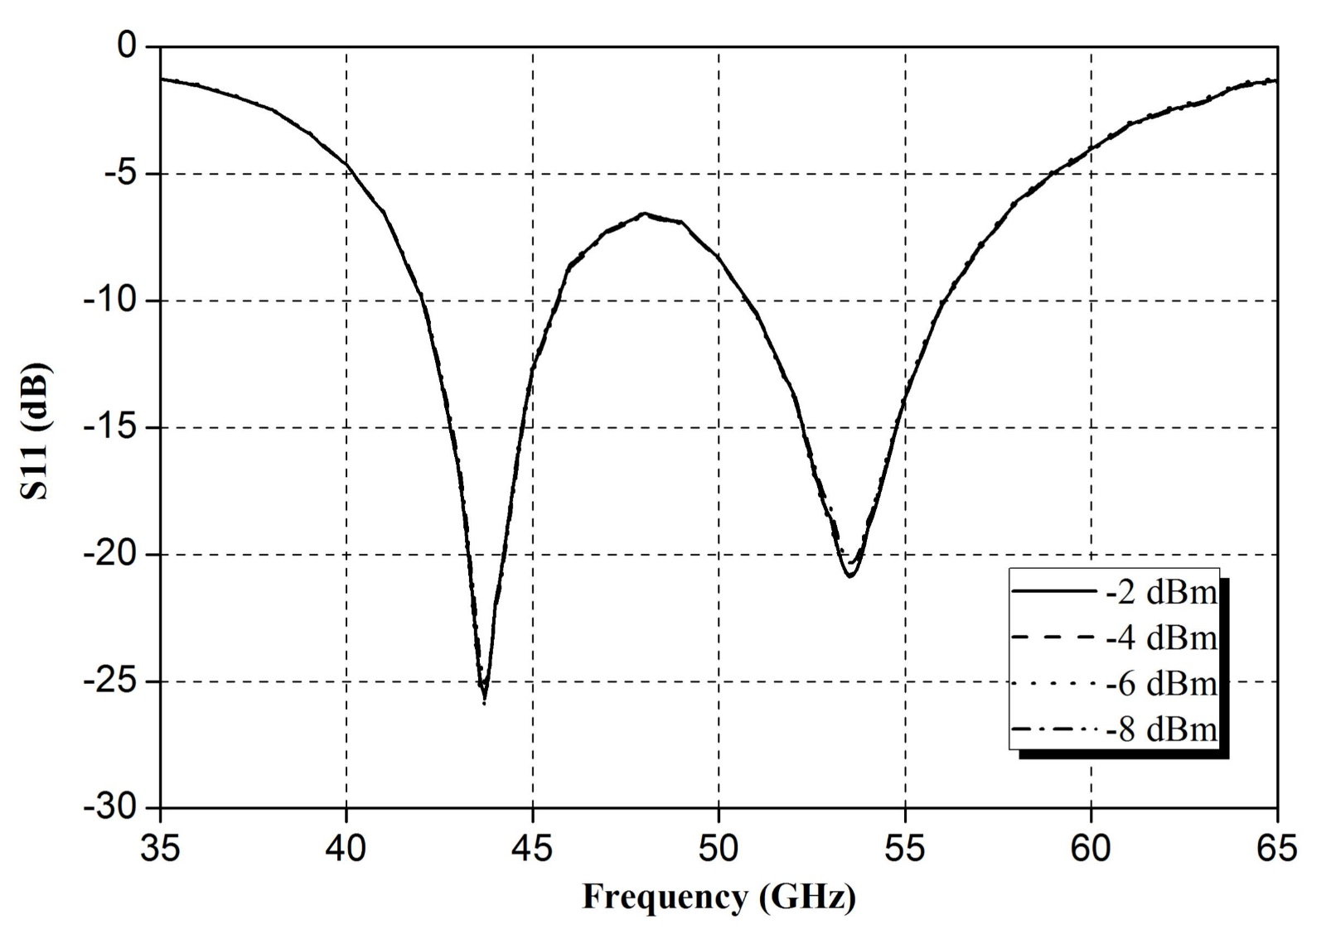
A Millimeter-Wave IGR
S₁₁ measurement
Notes:
Explain why the frequency is shifted to 53 GHz
MoM capacitors are not EM simulated (Parasitic itself and wiring parasitic)

Slide 45
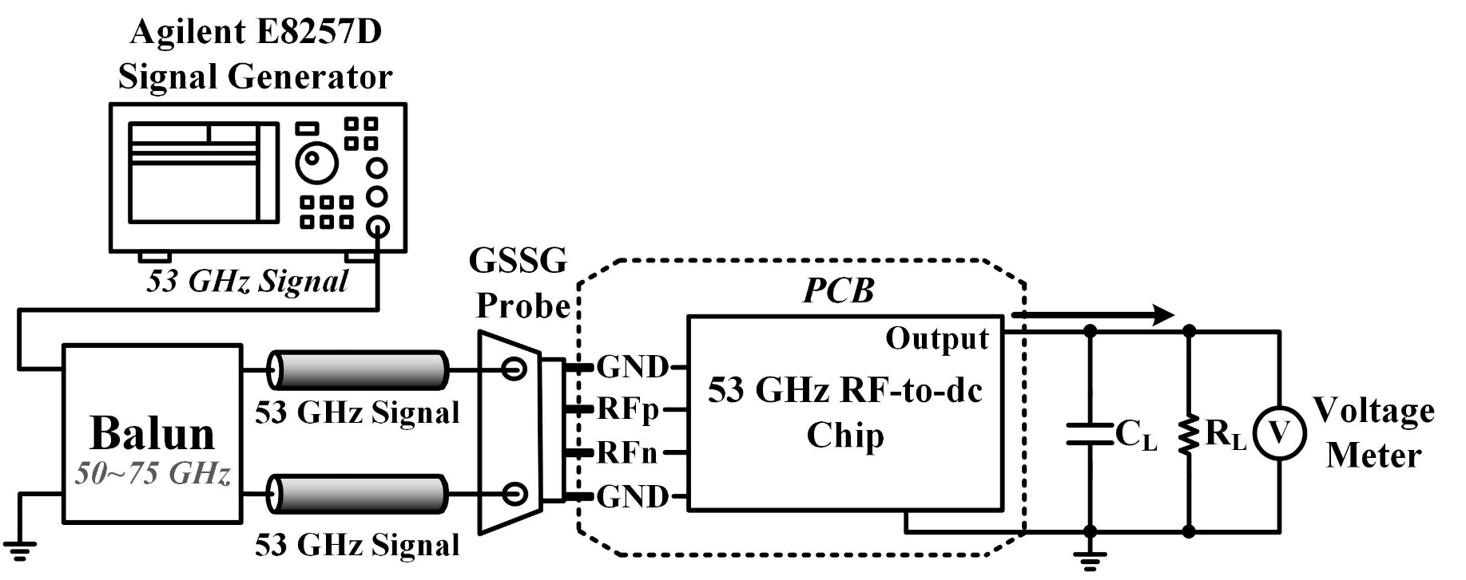
A Millimeter-Wave IGR
Measurement setup #1
Measure output voltage with various load resistors
This is the conventional rectifier measurement setup

Slide 46
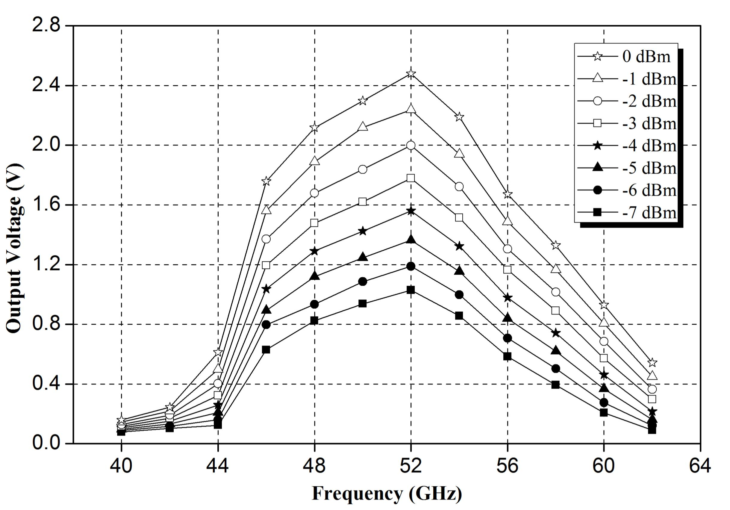
A Millimeter-Wave IGR
Broadband measurement with open-loaded IGR
Notes:
46-56 GHz is the 3 dB bandwidth

Slide 47
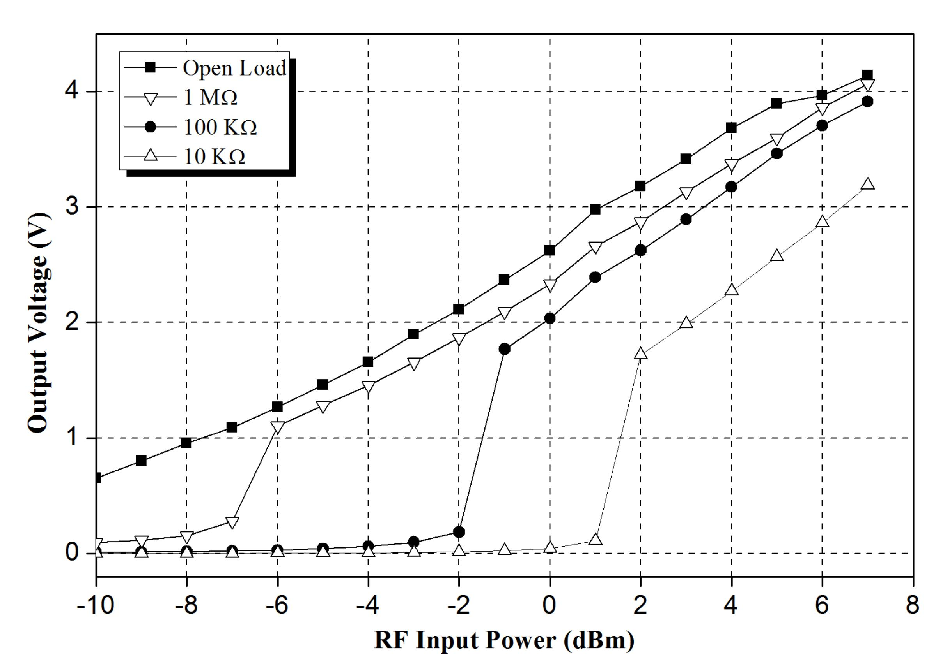
A Millimeter-Wave IGR
Measured output voltage with various load resistors
Notes:
Explain why the sensitivity drops as the load become smaller

Slide 48
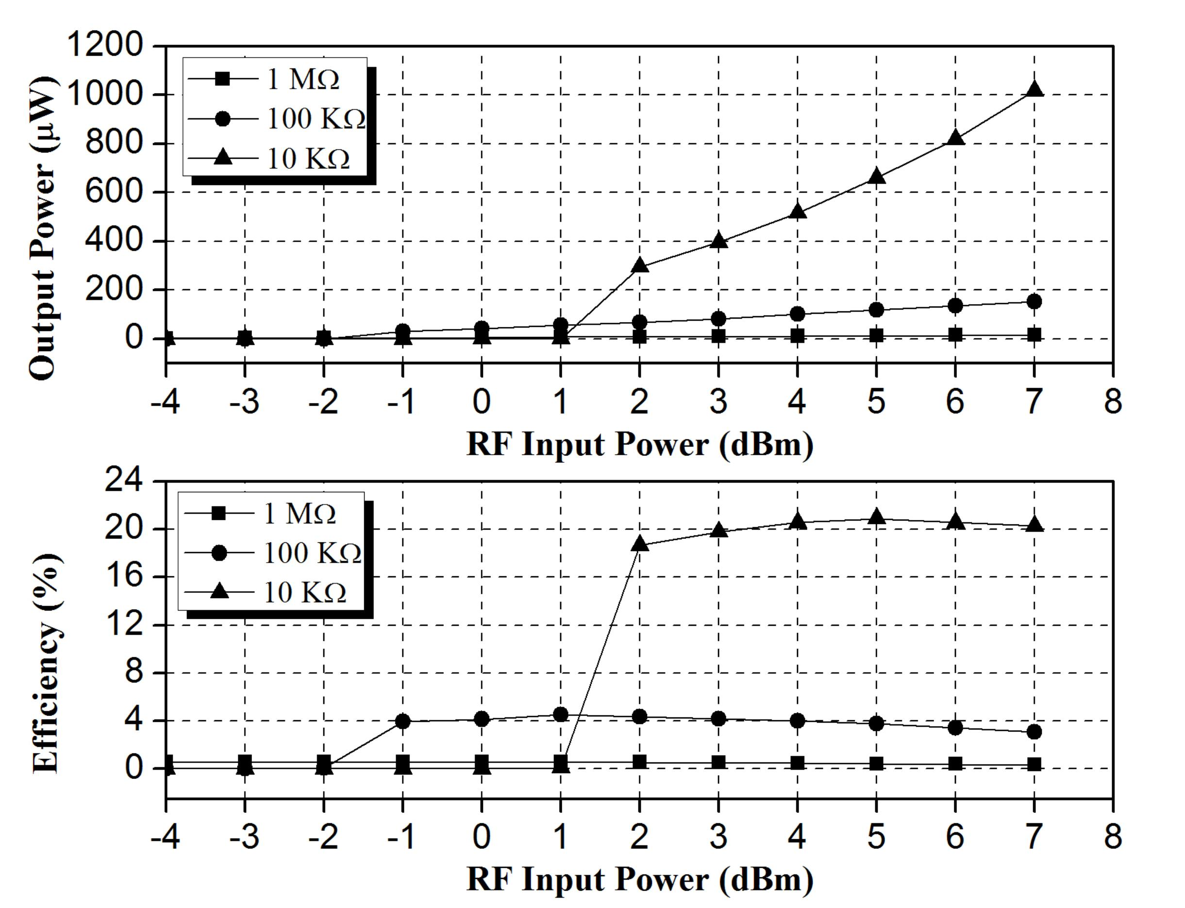
A Millimeter-Wave IGR
Measured output power and efficiency

Slide 49
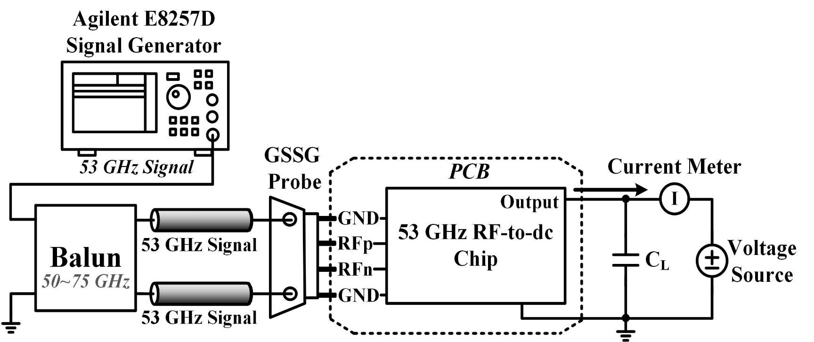
A Millimeter-Wave IGR
Measurement setup #2
Connect output to a voltage source and measure the output current
Convenient to find the IGR optimal load resistance

Slide 50

A Millimeter-Wave IGR
Measured peak output power and efficiency
Notes:
Explain that how to calculate the optimal load (V_{out}/I_{measured}). In the design, 10 kOhm is the optimal resistive load.
In practical RFID design, the optimal load is not what we need. We prefer a lower current consumption (larger resistive load).

Slide 51


A Millimeter-Wave IGR
Measured sensitivity (Target output voltage $=1.2 V$)
Notes:
Connect the result to the RFID tag design

Slide 52


A Millimeter-Wave IGR
Measured charging curve (Load is $610 pF$)
Notes:
Connect the result to the RFID tag design

Slide 53
Conclusion and Future Works

Slide 54

Conclusion and Future Works
Performance summary
 | This Work | RFIC 2013 [1] |  |  | JSSC 2010 [2]
Technology | $65$ nm | $65$ nm |  |  | $90$ nm
Die Area | $1$ mm² | $1.09$ mm² |  |  | $1.235$ mm²
Antenna Type | Loop | Monopole |  |  | N/A
Downlink Frequency | $60$ GHz | $71$ GHz |  |  | $45$ GHz
Downlink Mode | PWM | N/A |  |  | N/A
Uplink Frequency | $24$ GHz | $79$ GHz |  |  | $60$ GHz
Uplink Mode | FSK | OOK |  |  | PWM
Power Scavenging - Rectifier
Number of stages | $$7$$ |  | $$3$$ | $$10$$
Operating Frequency | $46−56$ GHz |  | $70−72$ GHz | $45$ GHz
Peak Efficiency | $20.65\%$ @7 dBm |  | $8\%$ @$5$ dBm | $0.5\%$ @$2$ dBm
Input Sensitivity | $−7$ dBm @$0.6$ μA, $1.2$ V |  | $5$ dBm @$1.6$ V | $2$ dBm @$700$μA, $0.9$ V

Slide 55
Conclusion and Future Works
IGR technique is accept by TMTT 2014
Title: “A Millimeter-Wave In-Phase Gate-Boosting Rectifier”
Future works
Antenna design
On-chip or off-chip?
Reduce tag power consumption
Further improve IGR
Increase number of stages
Increase input impedance of IPVM
Reduce ITC power consumption using gate-leakage or sub-threshold methods
Notes:
Antenna: On-chip or Off-chip are all possible as long as the size is small enough (Off-chip increases the cost)
Improve IGR: Increase number of stages, Zin of IPVM, and

Slide 56
Reference
[1] H. Gao, M. Matters-Kammerer, P. Harpe, D. Milosevic, U. Johannsen, A. van Roer-mund, and P. Baltus, "A 71 GHz RF energy harvesting tag with 8% efficiency for wireless temperature sensors in 65nm CMOS," in Proc. IEEE Radio Frequency Integr. Circuits Symp., Jun. 2013, pp. 403-406.
[2] S. Pellerano, J. Alvarado, and Y. Palaskas, "A mm-wave power-harvesting RFID tag in 90 nm CMOS," IEEE J. Solid-State Circuits, vol. 45, no. 8, pp. 1627-1637, Aug. 2010.
Notes:
Antenna: On-chip or Off-chip are all possible as long as the size is small enough (Off-chip increases the cost)
Improve IGR: Increase number of stages, Zin of IPVM, and

Slide 57
Thank you ☺

